Slide 1
Equation relating speed, frequency, and wavelength of a wave

Slide 2
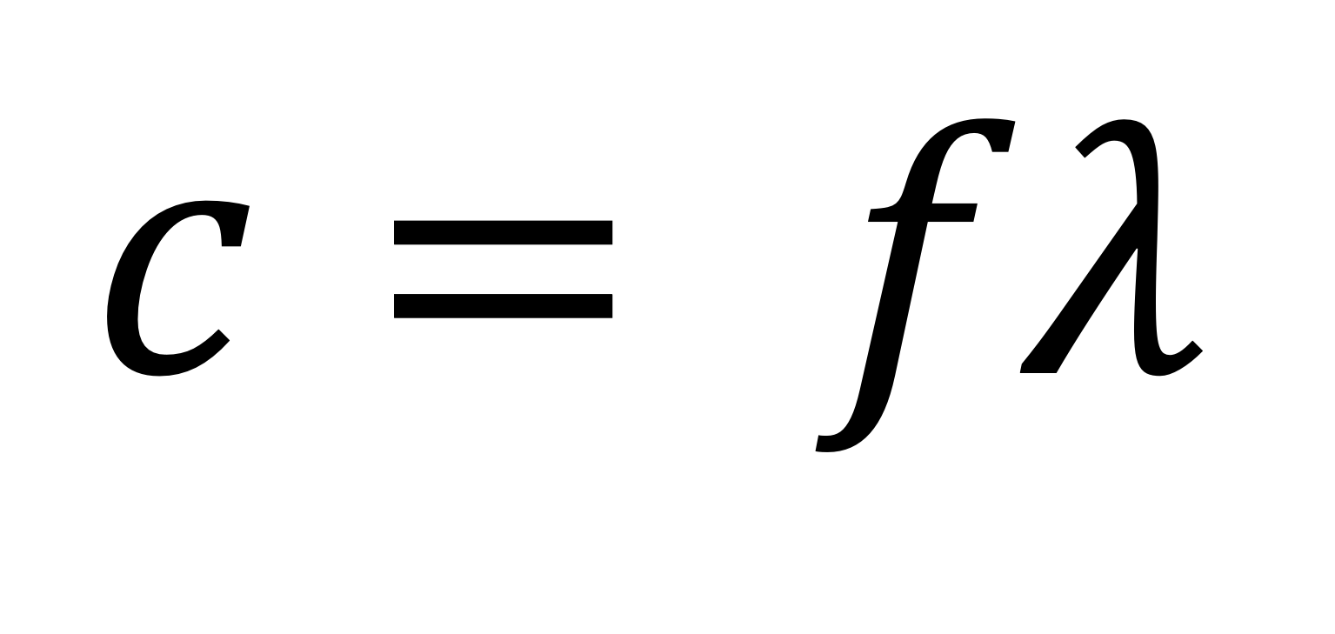
$$c= fλ$$

Slide 3
Definition of
PERIOD (T)

Slide 4
Time taken for one complete oscillation (measured in seconds)

Slide 5
Definition of
FREQUENCY (f)

Slide 6
Number of complete oscillations per second

Slide 7
Equation relating frequency and period of an oscillation

Slide 8
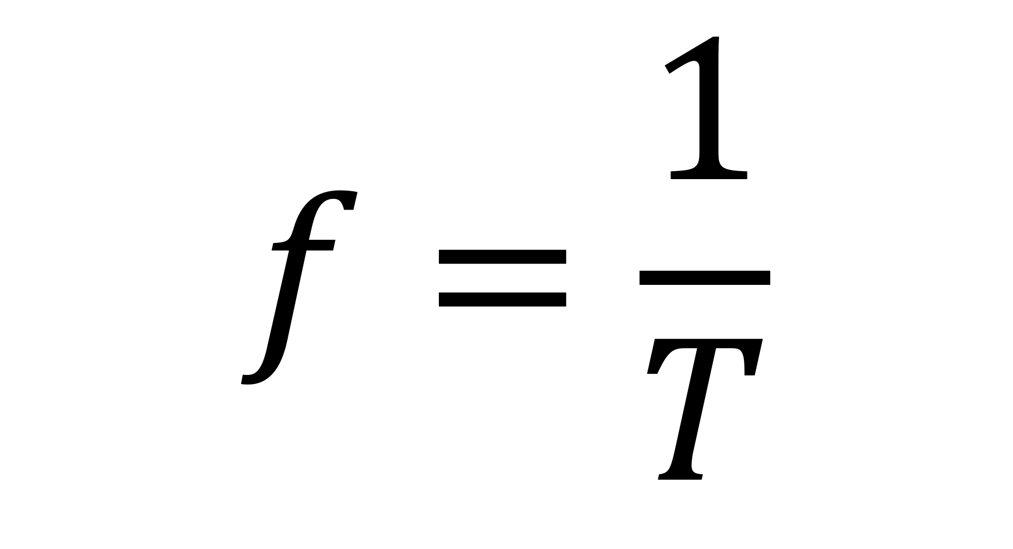
$$f=\frac{1}{T}$$

Slide 9
Equation for finding the frequency of the first harmonic for stationary waves on a string

Slide 10
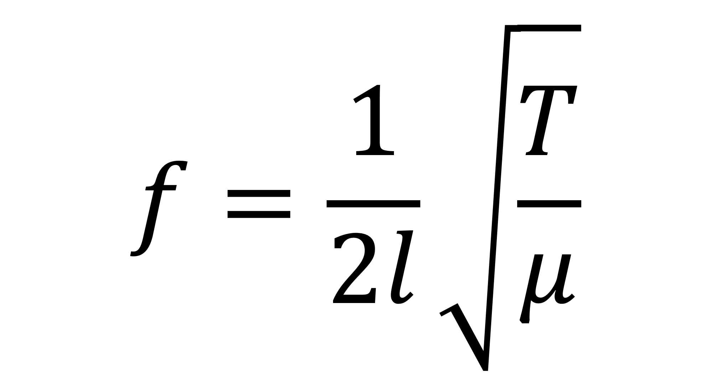
$$f=\frac{1}{2l}\sqrt{\frac{T}{μ}}$$

Slide 11
Equation for the double slit experiment, relating fringe separation, slit spacing, distance from screen, and wavelength of light.

Slide 12
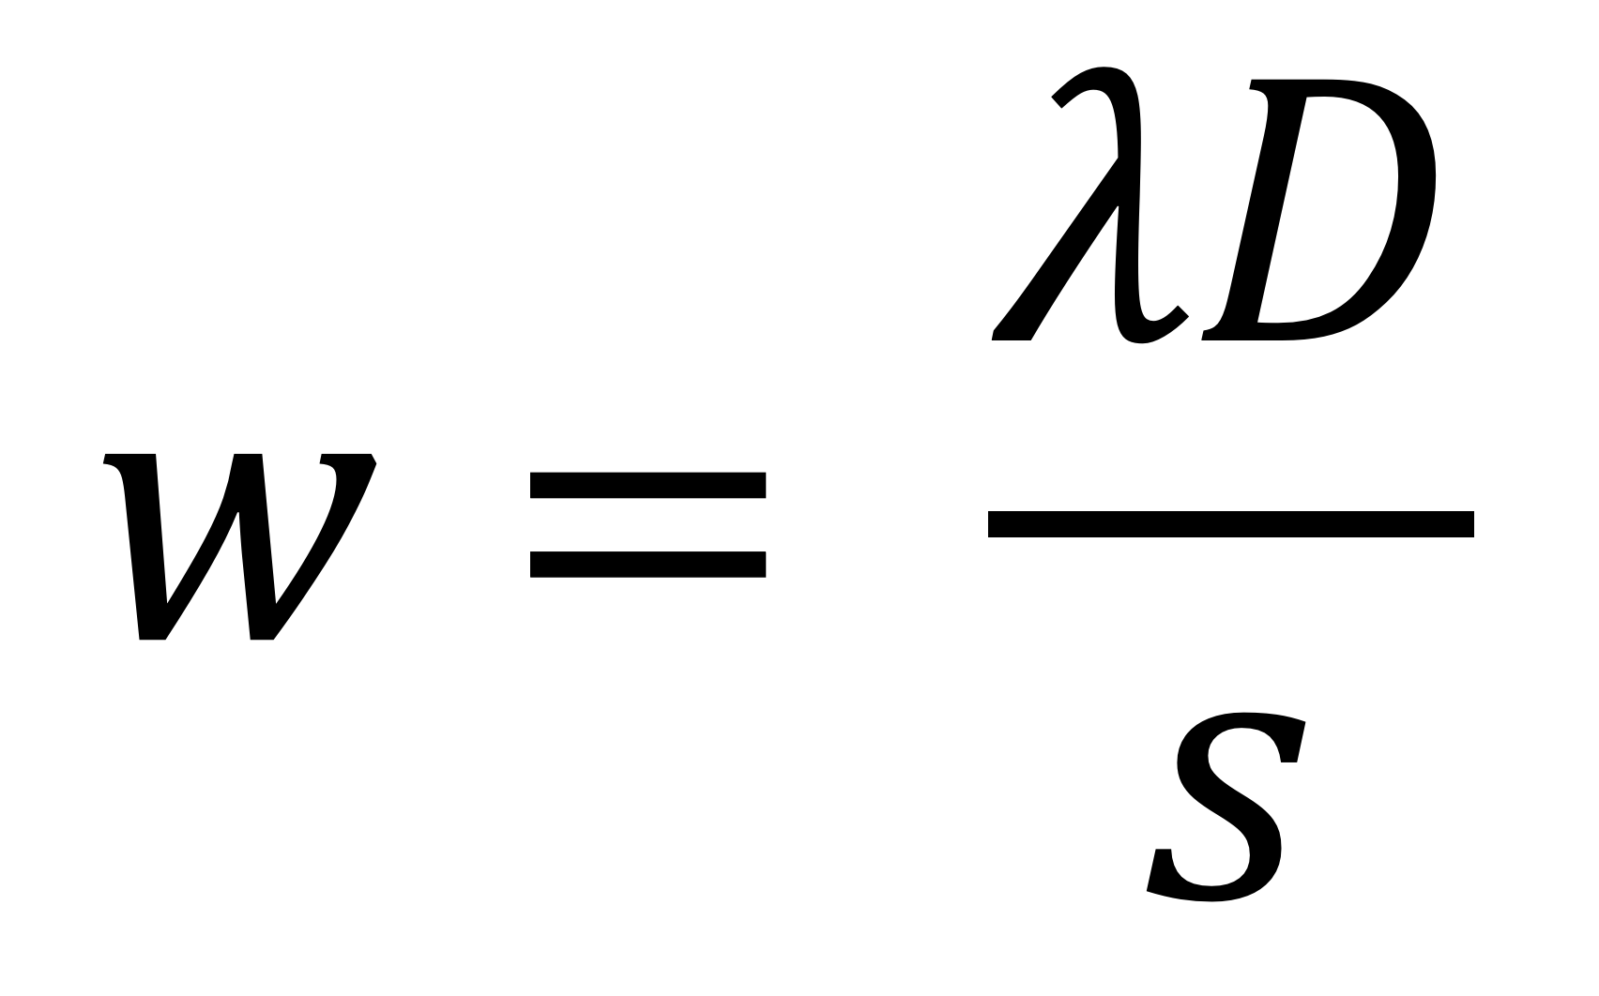
$$w= \frac{λD}{s}$$

Slide 13
Equation for diffraction grating

Slide 14
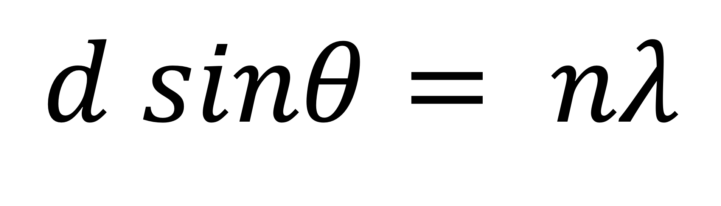
$$d sinθ= nλ$$

Slide 15
Formula for refractive index of a substance

Slide 16
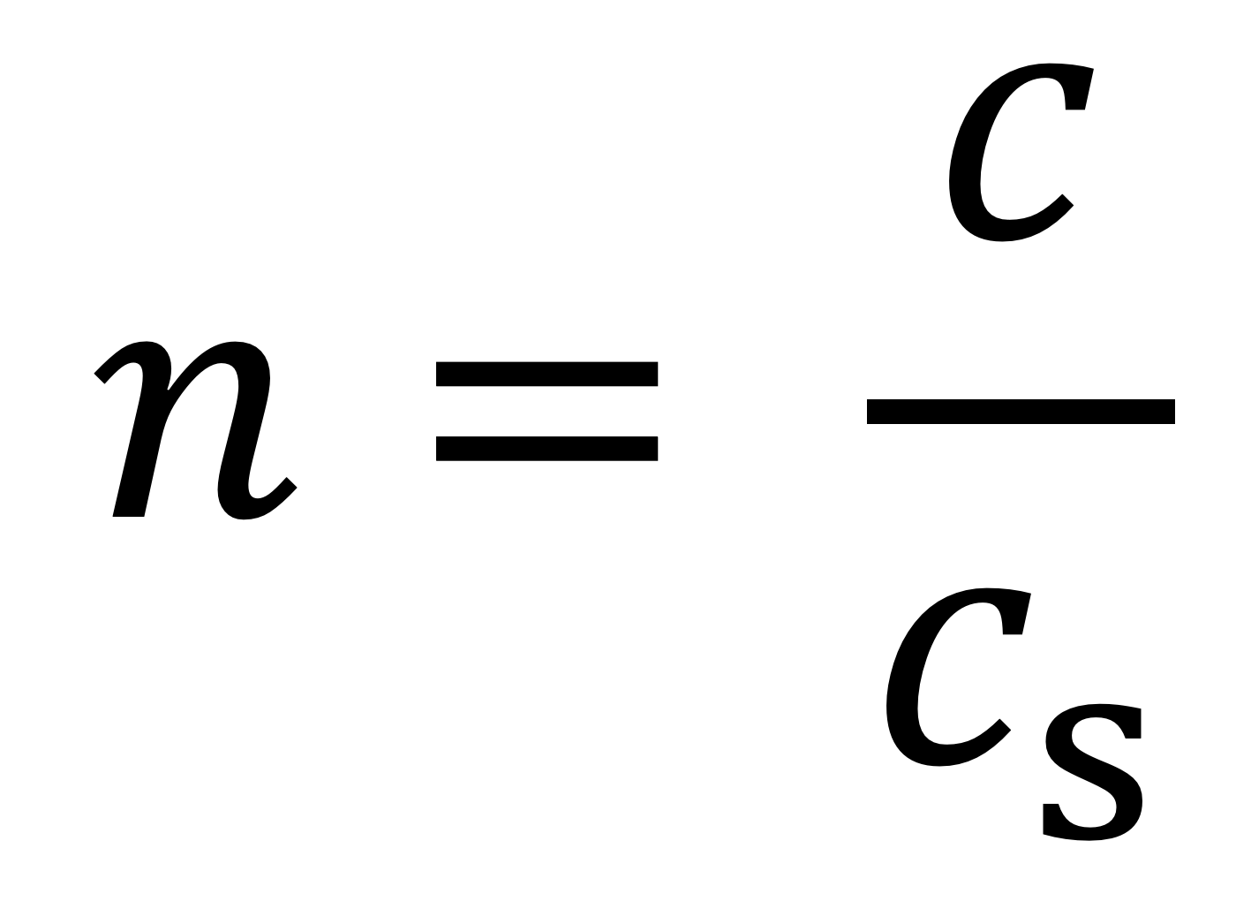
$$n= \frac{c}{c_{s}}$$

Slide 17
Law of Refraction

Slide 18
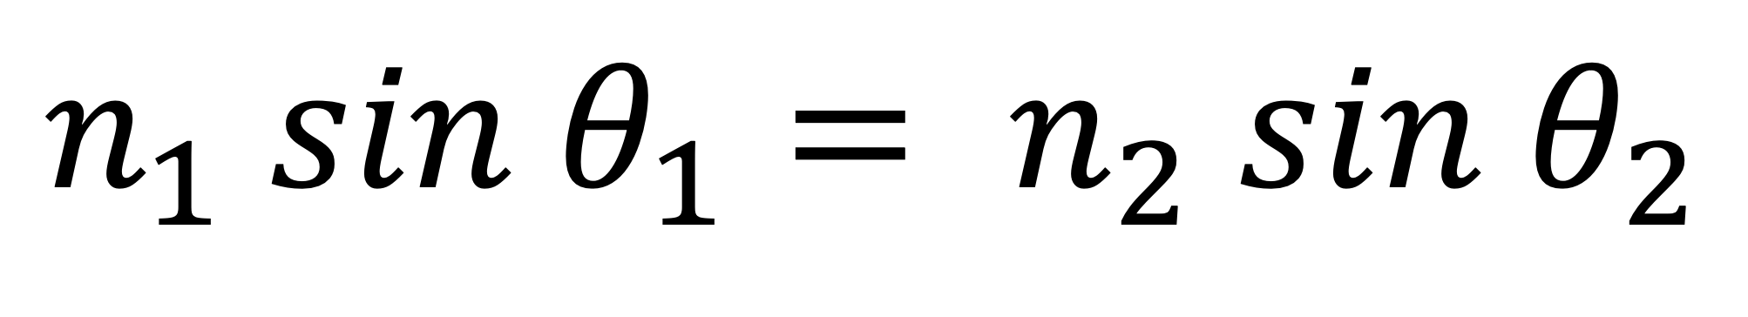
$$n_{1} sin θ_{1}= n_{2} sin θ_{2}$$

Slide 19
Critical Angle

Slide 20
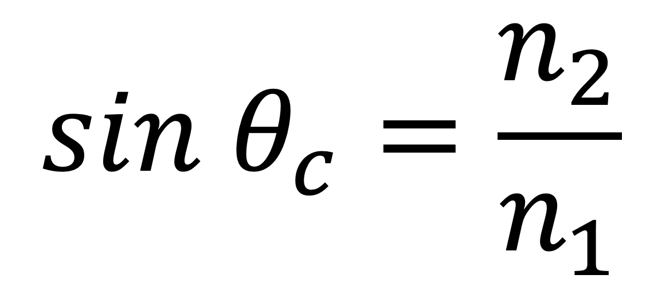
$$sin θ_{c}=\frac{n_{2}}{n_{1}}$$
for n₁ > n₂

Slide 21
Moment of a Force

Slide 22
Force × perpendicular distance from the pivot, Fd

Slide 23
Word definition of velocity

Slide 24
Rate of change of displacement

Slide 25
Definition of velocity in symbols

Slide 26
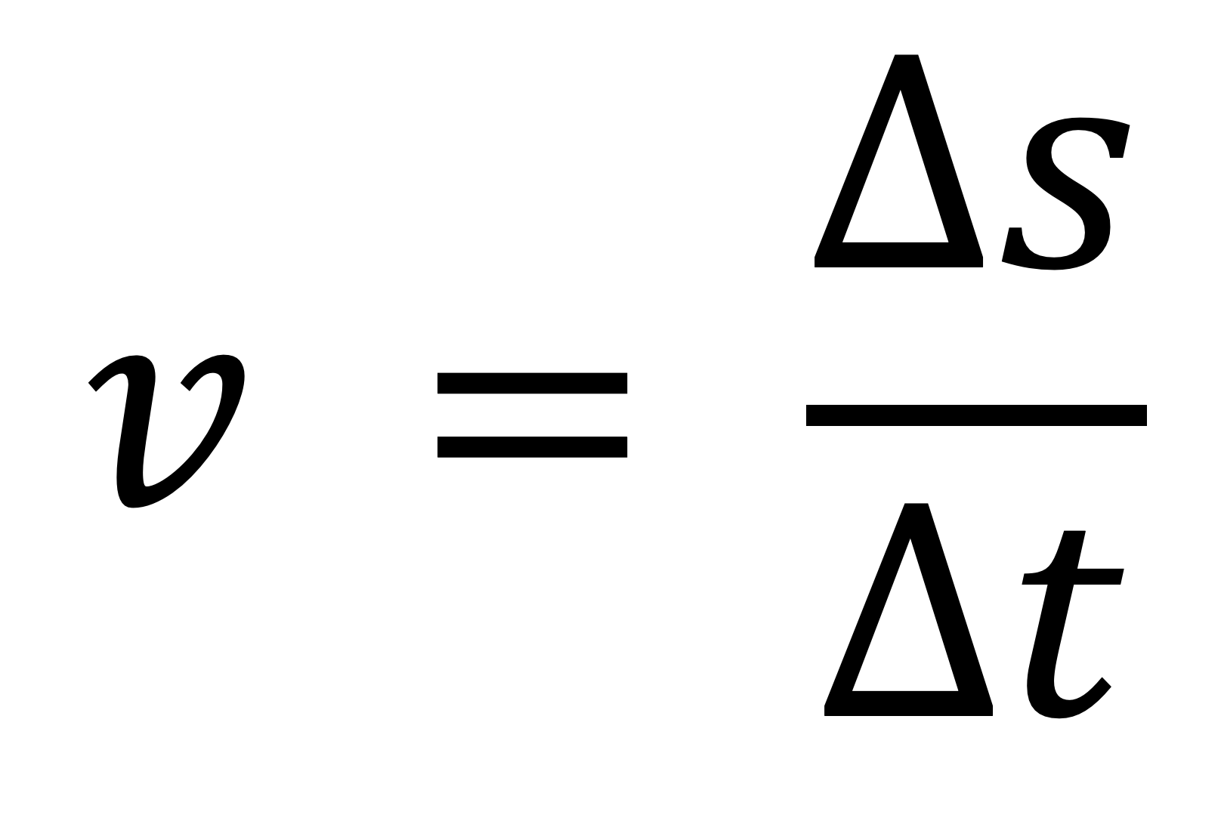
$$v = \frac{Δs}{Δt}$$

Slide 27
Word definition of acceleration

Slide 28
Rate of change of velocity

Slide 29
Definition of acceleration in symbols

Slide 30
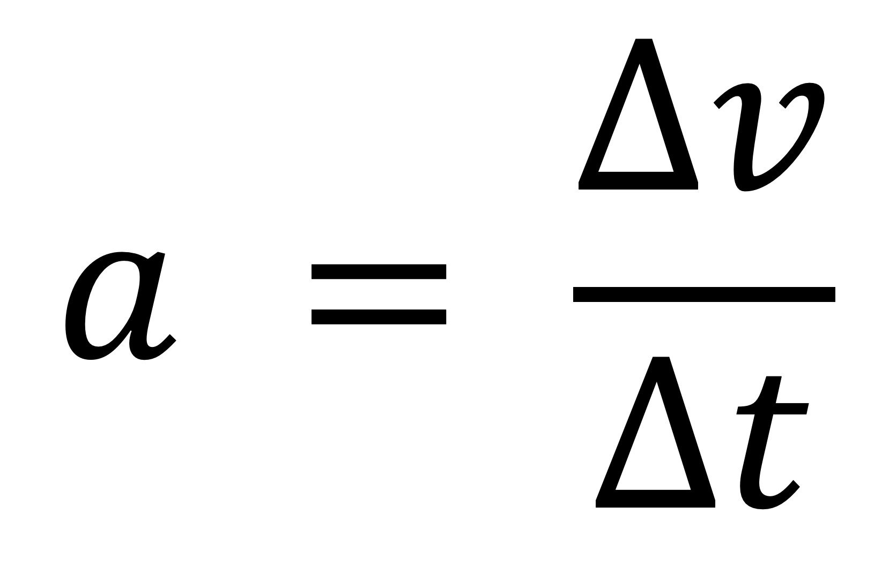
$$a = \frac{Δv}{Δt}$$

Slide 31
Equations of motion for uniform acceleration (the “suvat” equations)

Slide 32

$$v=u+at$$
$$s=\left(\frac{u+v}{2}\right)t$$
$$v^{2}= u^{2}+2as$$
$$s=ut+\frac{1}{2}at^{2}$$

Slide 33
Equation relating force, mass, and acceleration

Slide 34
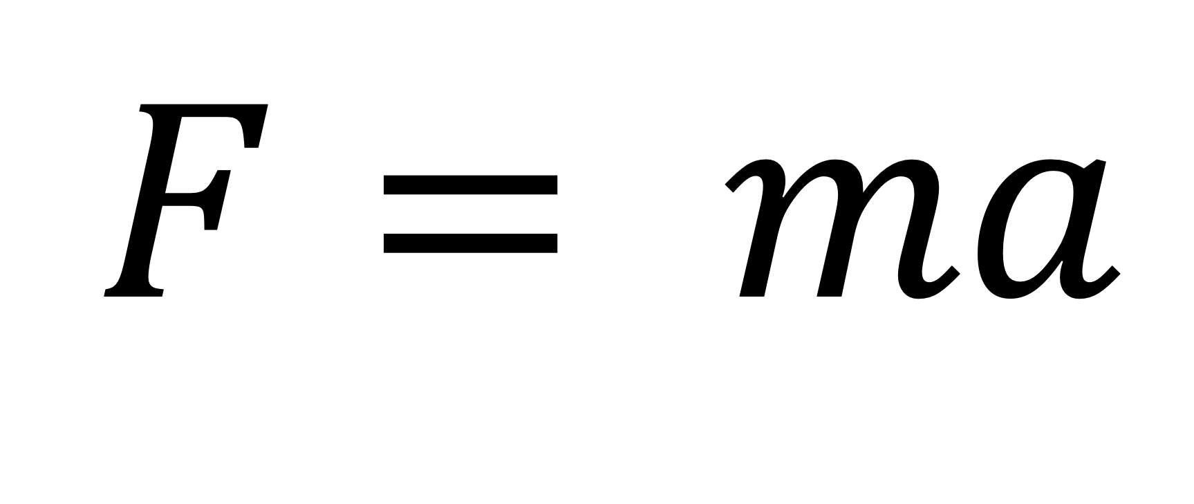
$$F= ma$$

Slide 35
Definition of momentum (p)

Slide 36
momentum = mass × velocity p = mv

Slide 37
Definition of impulse

Slide 38
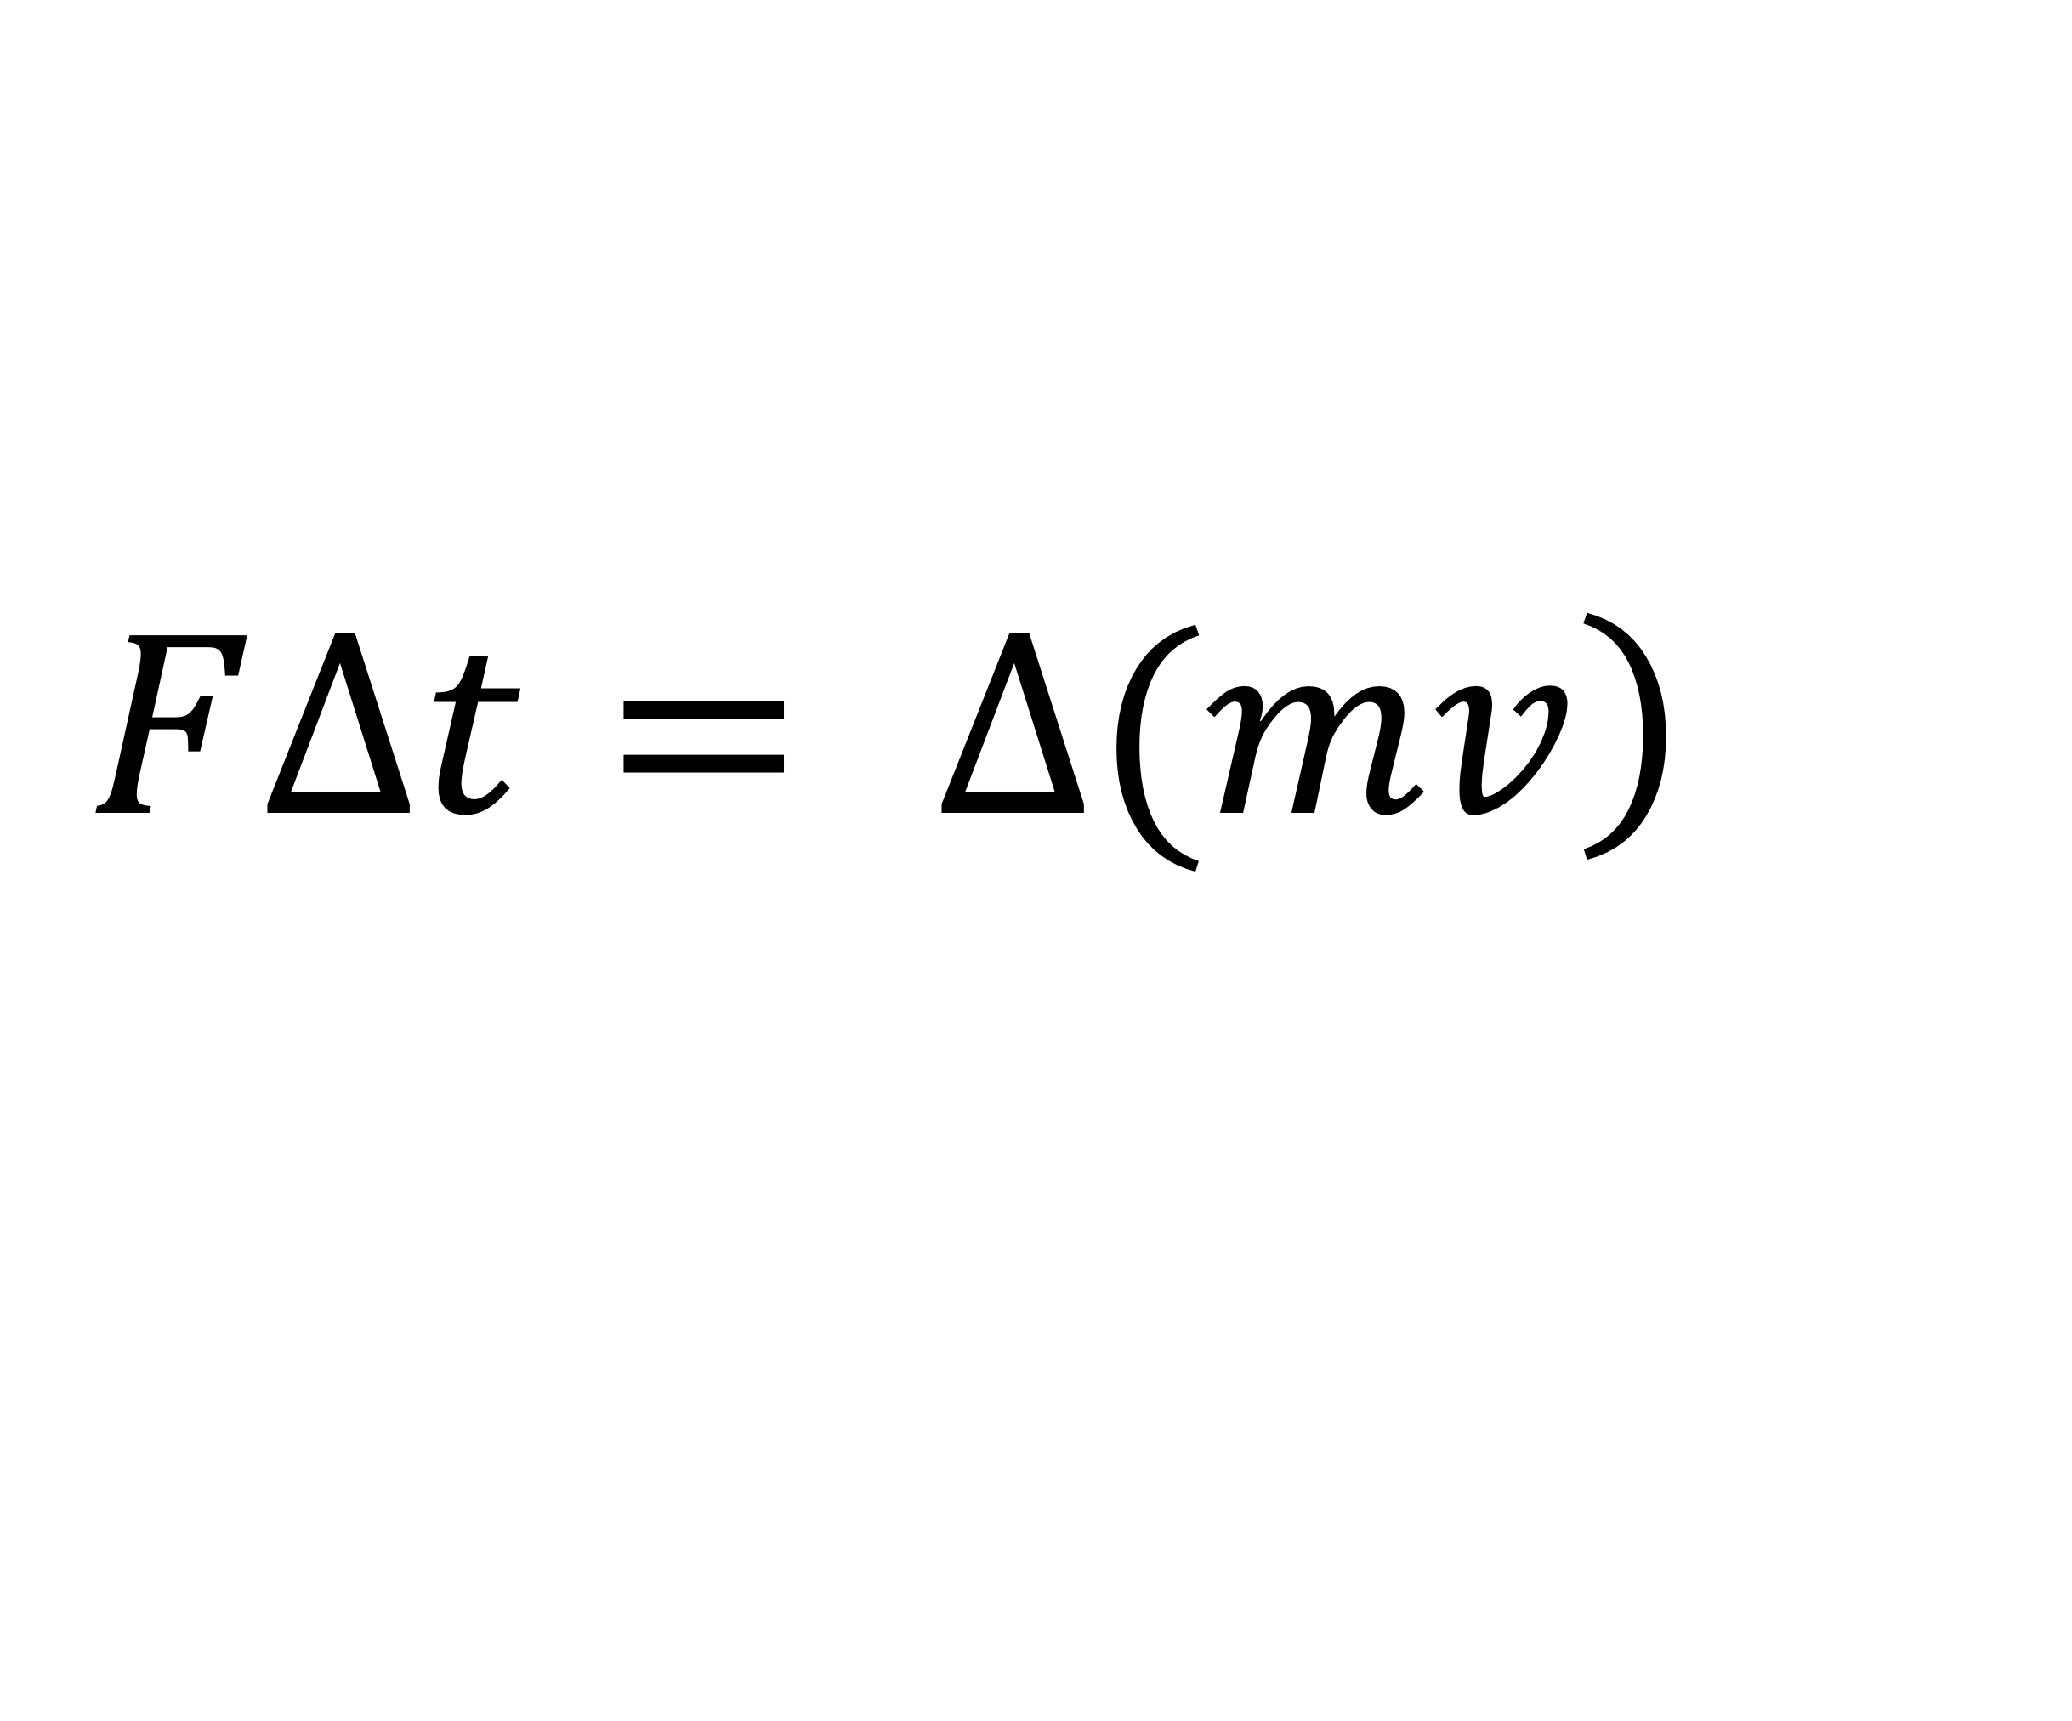
$$\left.F∆t= ∆(mv\right)$$

Slide 39
Equation relating force, momentum, and time in words

Slide 40
Force = rate of change of momentum

Slide 41
Equation relating force, momentum, and time in symbols

Slide 42
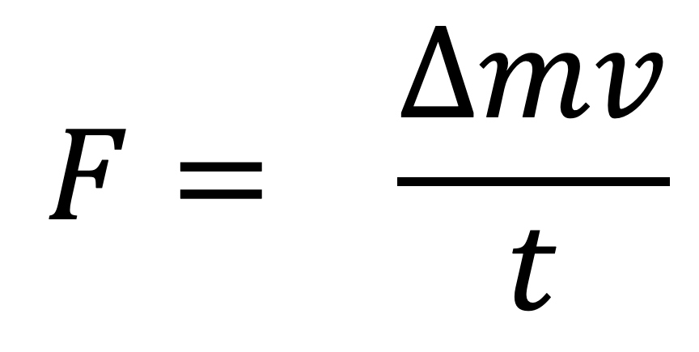
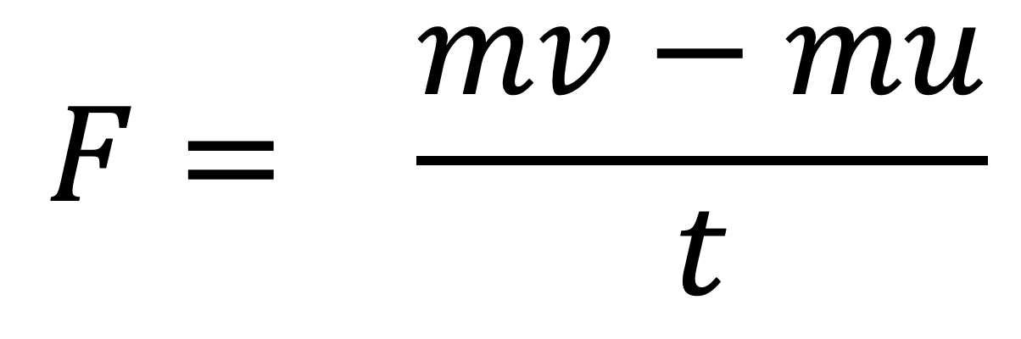
$$F= \frac{mv−mu}{t}$$
or
$$F= \frac{∆mv}{t}$$

Slide 43
Equation relating work done, force, and distance

Slide 44
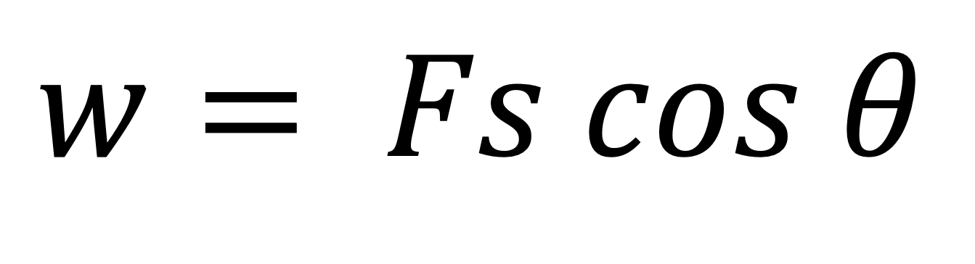
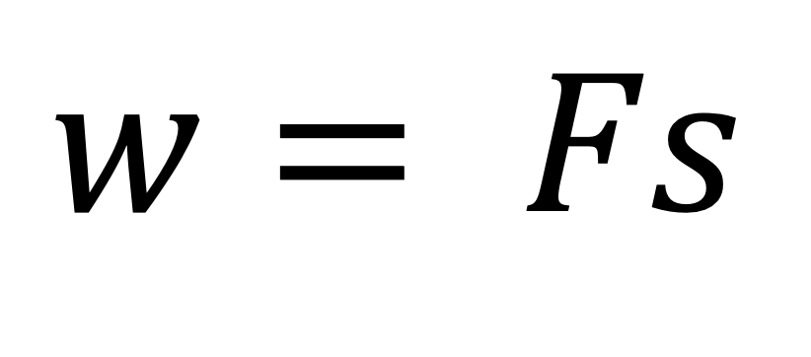
$$w= Fs$$
or
$$w= Fs cos θ$$

Slide 45
Equation for kinetic energy

Slide 46
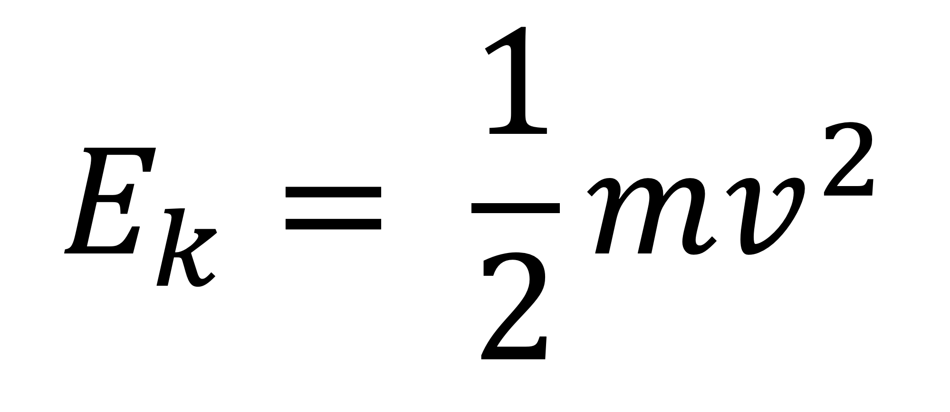
$$E_{k}= \frac{1}{2}mv^{2}$$

Slide 47
Equation for gravitational potential energy

Slide 48
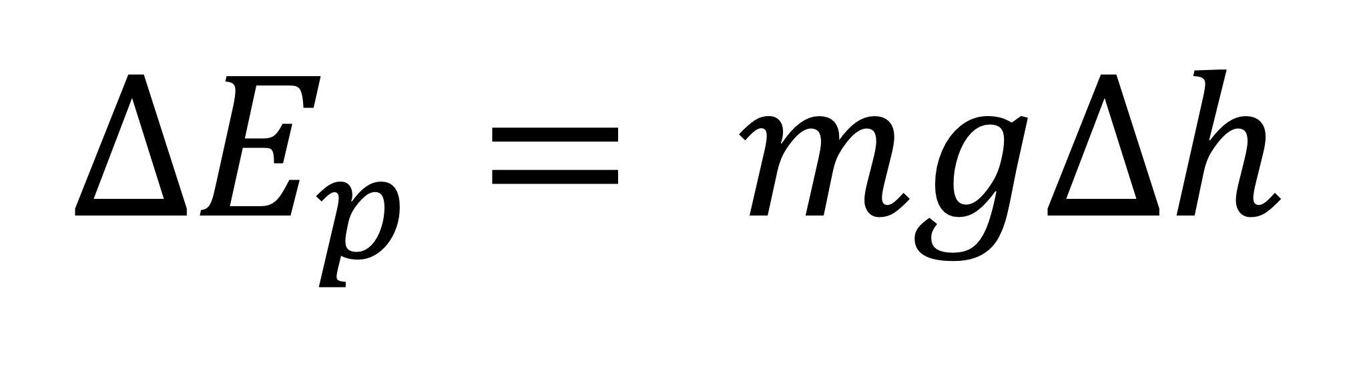
$$∆E_{p}= mg∆h$$

Slide 49
Definition of
POWER in words

Slide 50
Power is the rate of conversion of energy

Slide 51
Definition of
POWER (P) in symbols

Slide 52
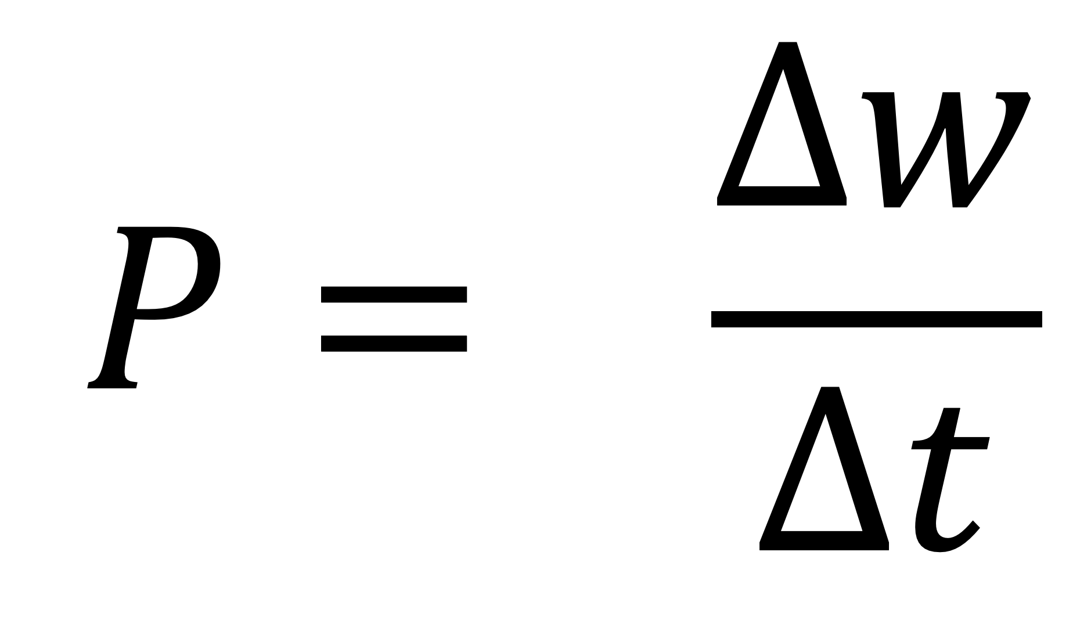
$$P= \frac{∆w}{∆t}$$

Slide 53
Equation relating power, force, and velocity

Slide 54
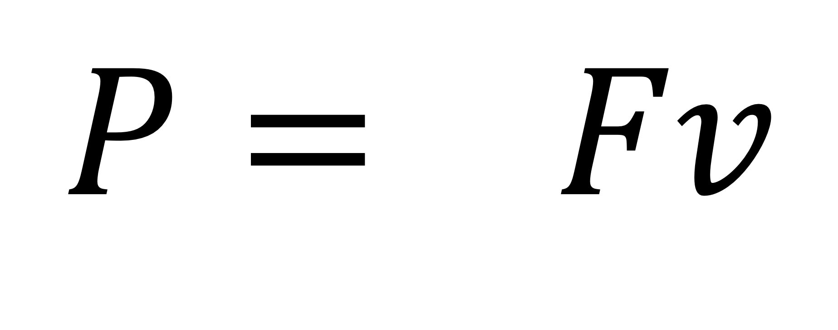
$$P= Fv$$

Slide 55
Definition of
EFFICIENCY

Slide 56
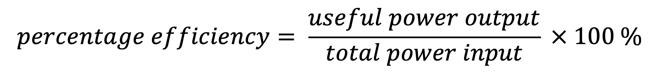
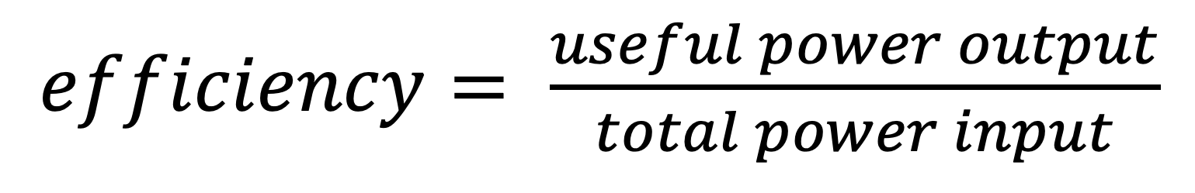
$efficiency= \frac{useful power output}{total power input}$
$$percentage efficiency= \frac{useful power output}{total power input} × 100 \%$$

Slide 57
Definition of
DENSITY

Slide 58
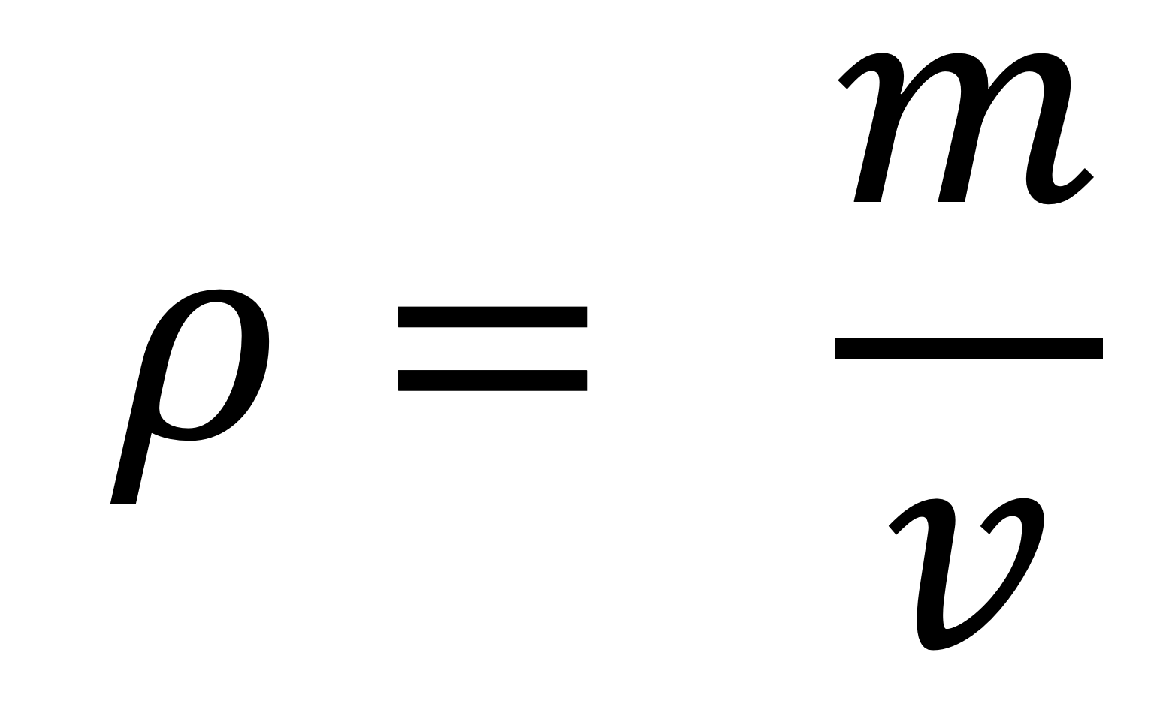
$$ρ= \frac{m}{v}$$

Slide 59
Hooke’s Law

Slide 60
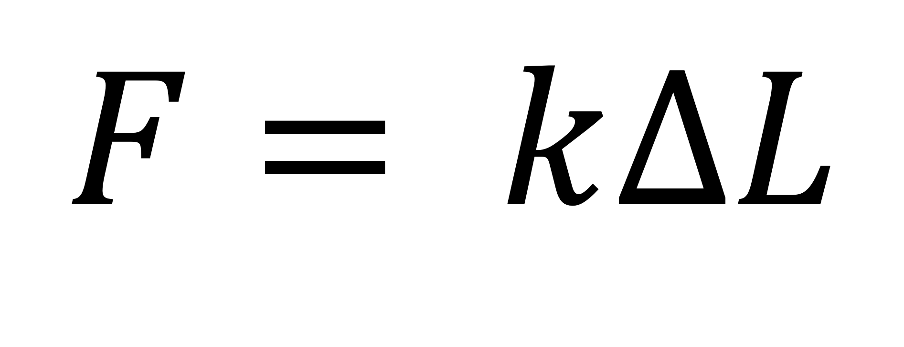
$$F= k∆L$$

Slide 61
Young Modulus

Slide 62
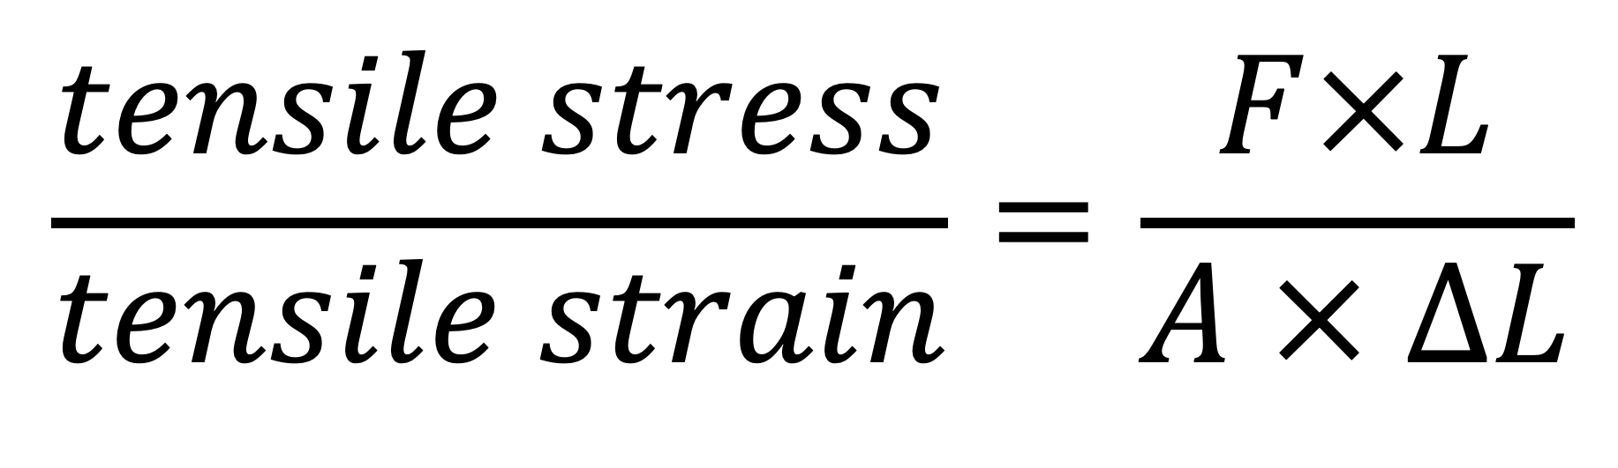
$$\frac{tensile stress}{tensile strain}=\frac{F×L}{A × ∆L}$$

Slide 63
Tensile Stress

Slide 64

$$\frac{F}{A}$$

Slide 65
Tensile Stress

Slide 66
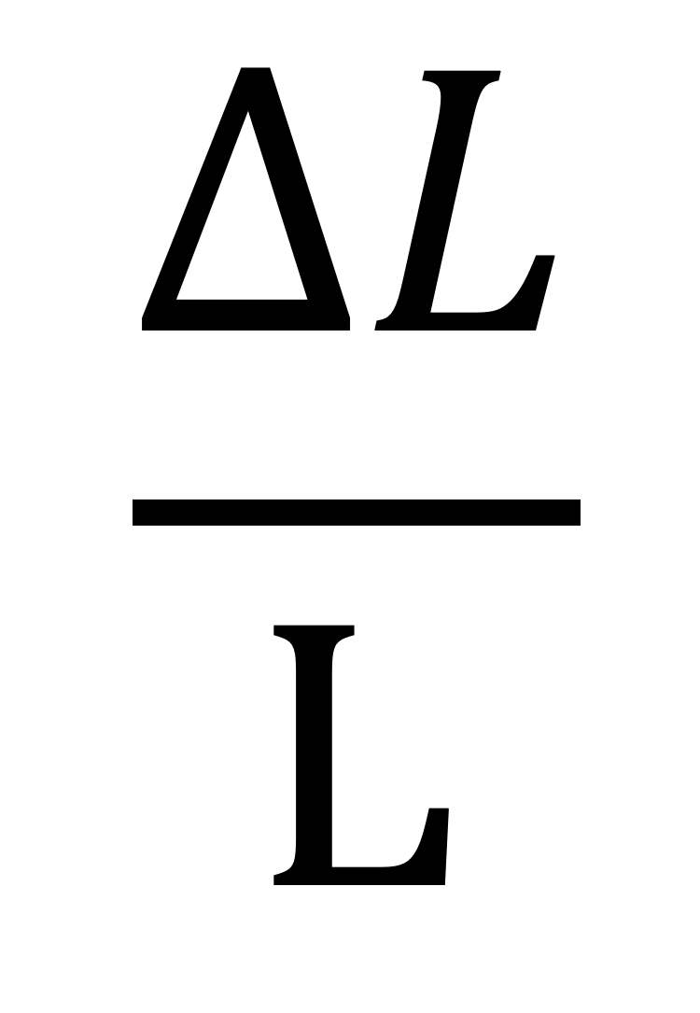
$$\frac{ΔL}{L}$$

Slide 67
Equation for calculating energy stored in a stretched or compressed material obeying Hooke’s Law

Slide 68
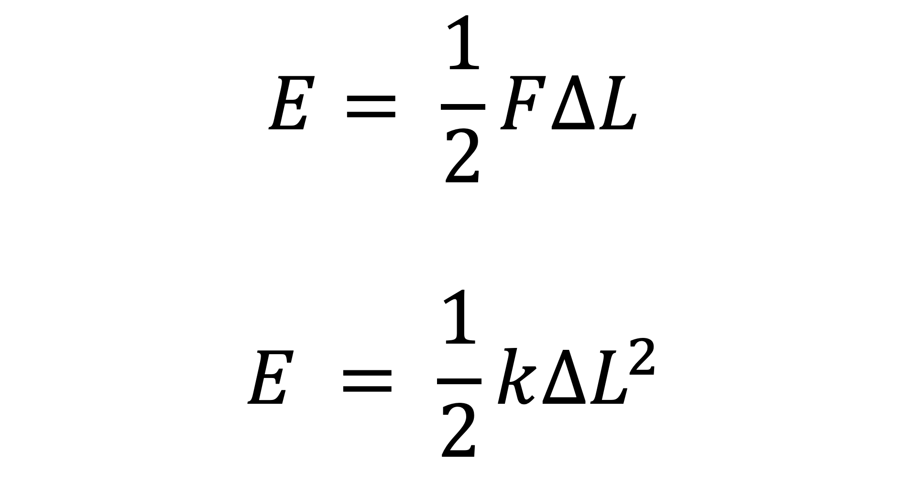
$$E= \frac{1}{2}F∆L$$
$$E = \frac{1}{2}k∆L^{2}$$

Slide 69
Equation for calculating energy stored per unit volume for a stretched or compressed material obeying Hooke’s Law

Slide 70
½ stress × strain

Slide 71
Definition of
WEIGHT

Slide 72

$$W=mg$$

Slide 73
Equation for energy of a photon

Slide 74
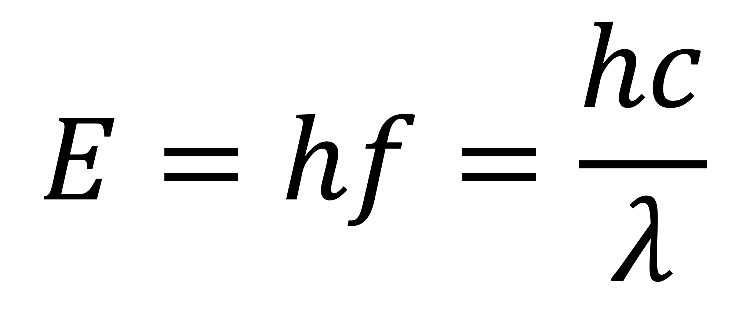
$$E=hf=\frac{hc}{λ}$$

Slide 75
Photoelectric effect equation

Slide 76
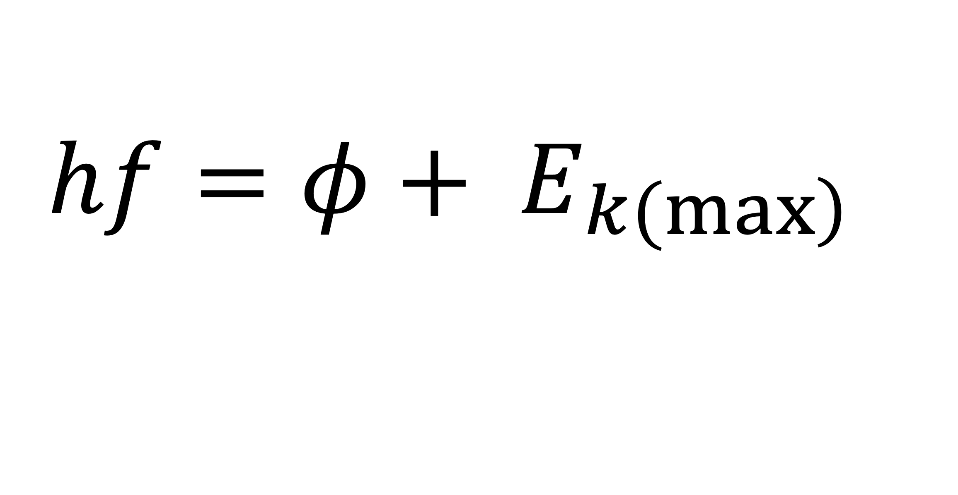
$$hf=φ+ E_{\left.k(max\right)}$$

Slide 77
de Broglie wavelength

Slide 78
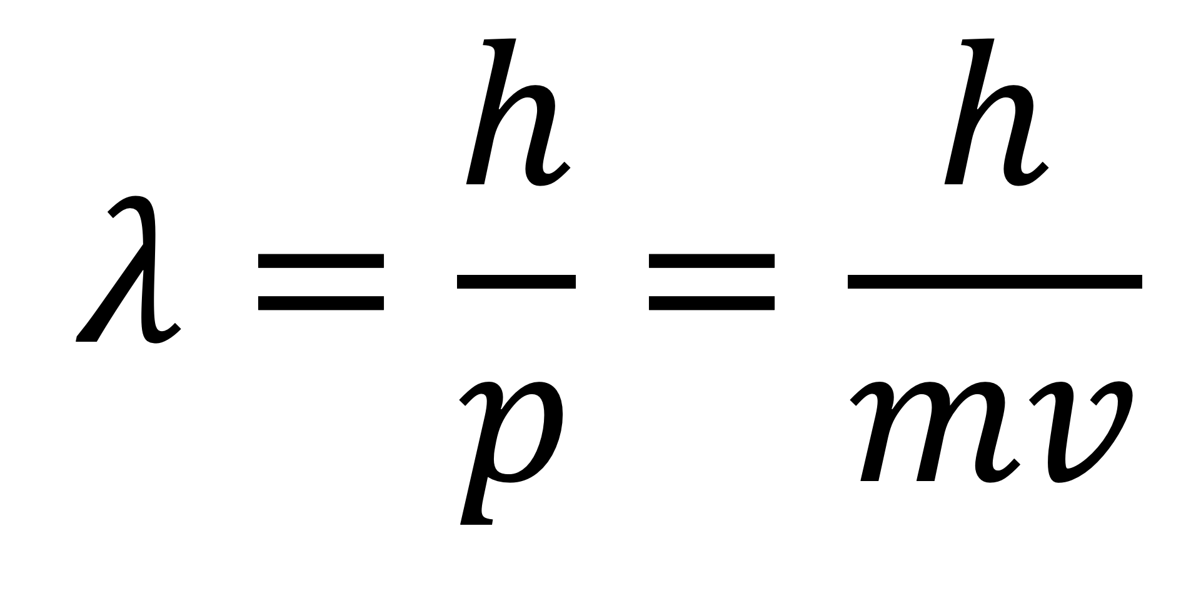
$$λ=\frac{h}{p}=\frac{h}{mv}$$

Slide 79
Definition of
Work Function

Slide 80
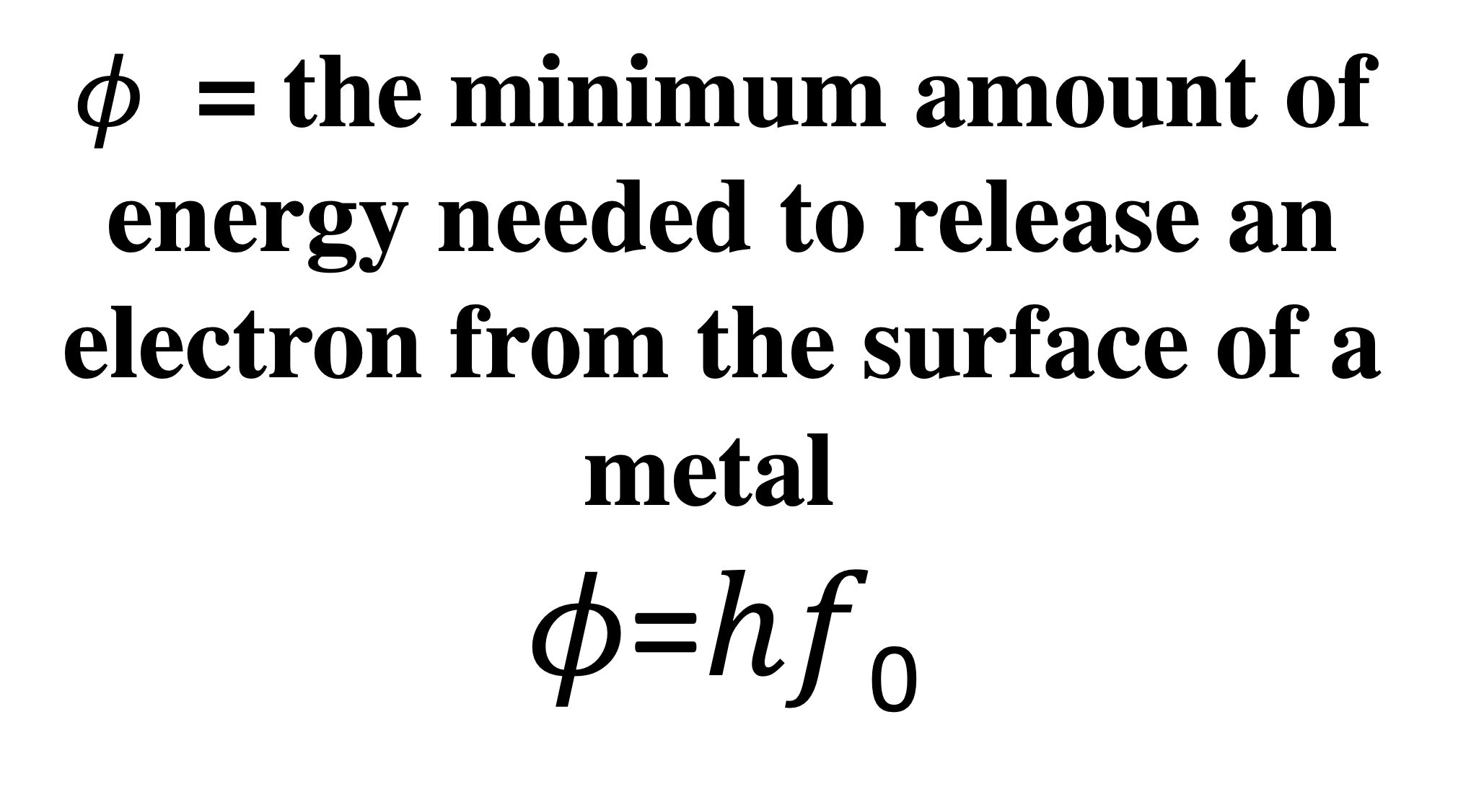
$φ$ = the minimum amount of energy needed to release an electron from the surface of a metal
𝜙=ℎ𝑓₀

Slide 81
Definition of
Stopping Potential

Slide 82
Stopping potential, 𝑉_{𝑠} is the potential difference needed to stop the fastest moving electron in a photocell experiment
E_{k(max)} = eV_{s}

Slide 83
Definition of
Specific Charge

Slide 84
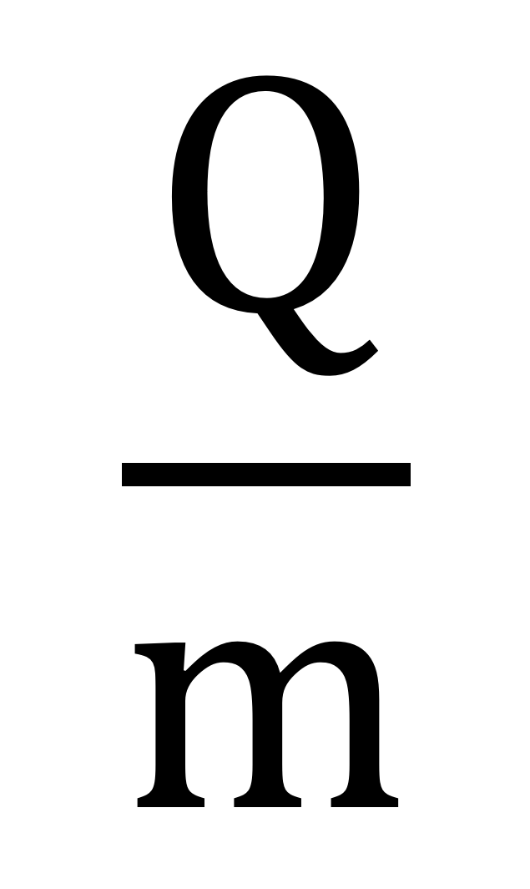
$$\frac{Q}{m}$$

Slide 85
Equation relating current, charge, and time

Slide 86
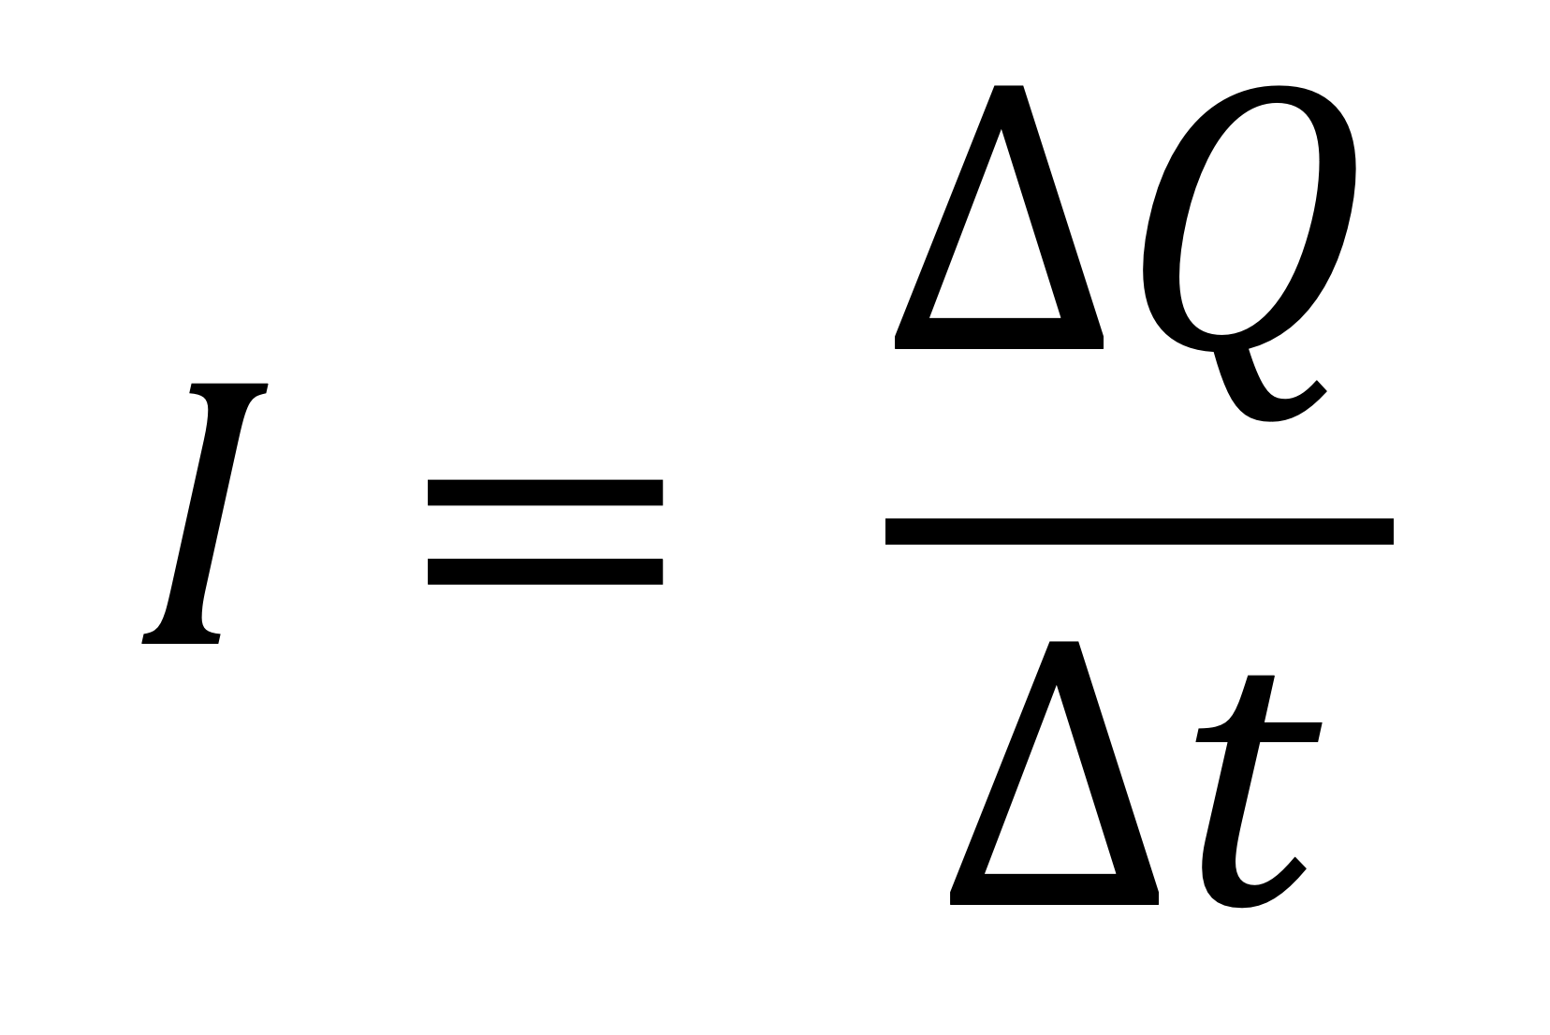
$$I= \frac{∆Q}{∆t}$$

Slide 87
Equation relating p.d., work done, and charge

Slide 88
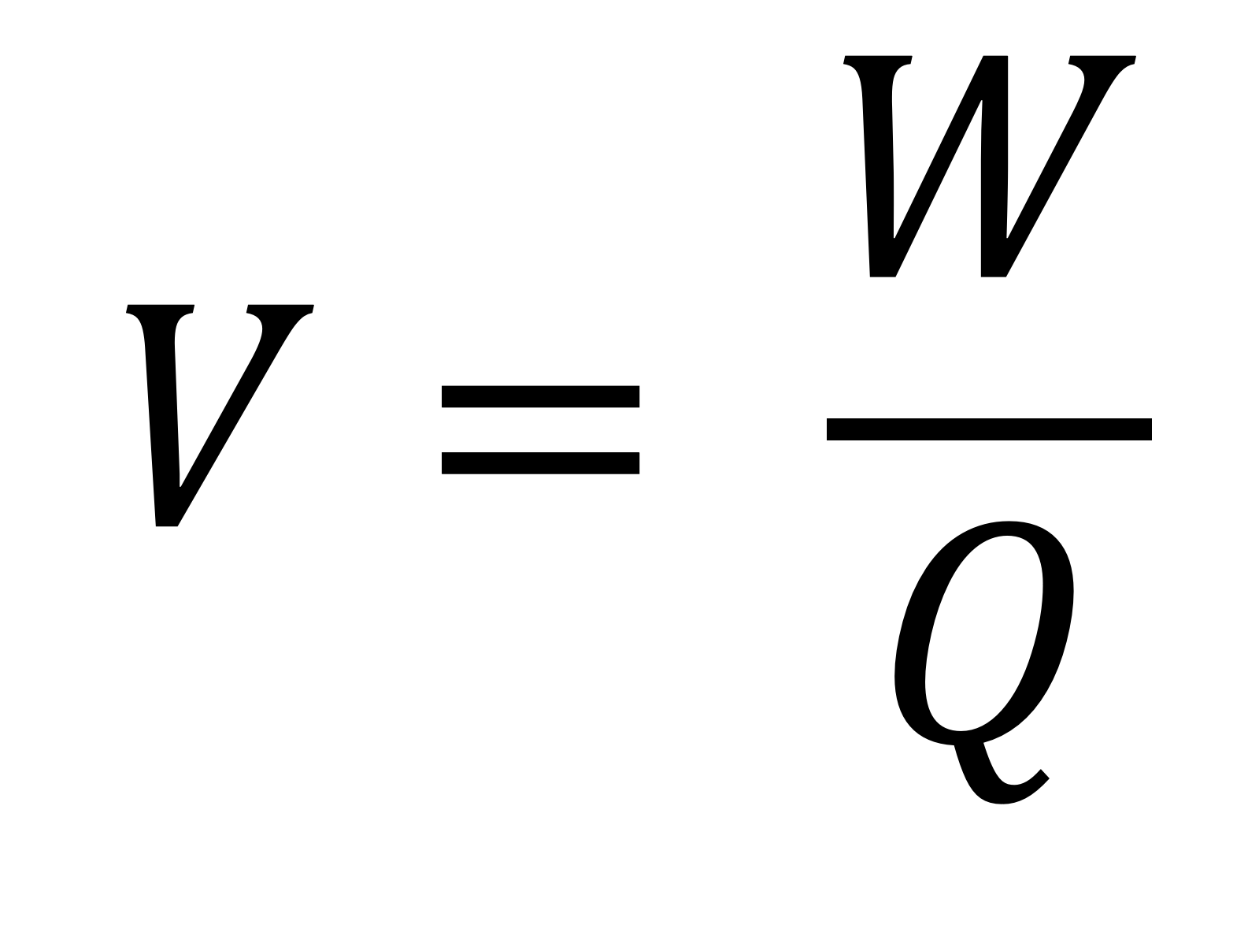
$$V= \frac{W}{Q}$$

Slide 89
Definition of the VOLT

Slide 90
1 joule per coulomb

Slide 91
Equation relating p.d., current, and resistance

Slide 92
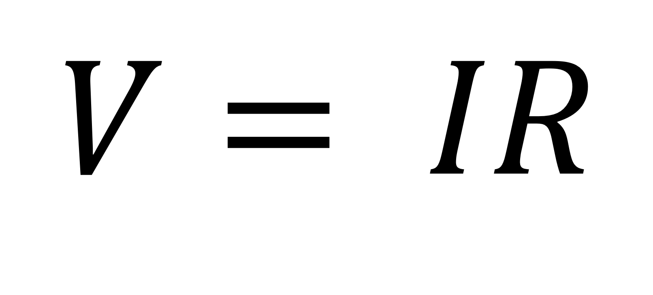
$$V= IR$$

Slide 93
Equation defining resistivity

Slide 94
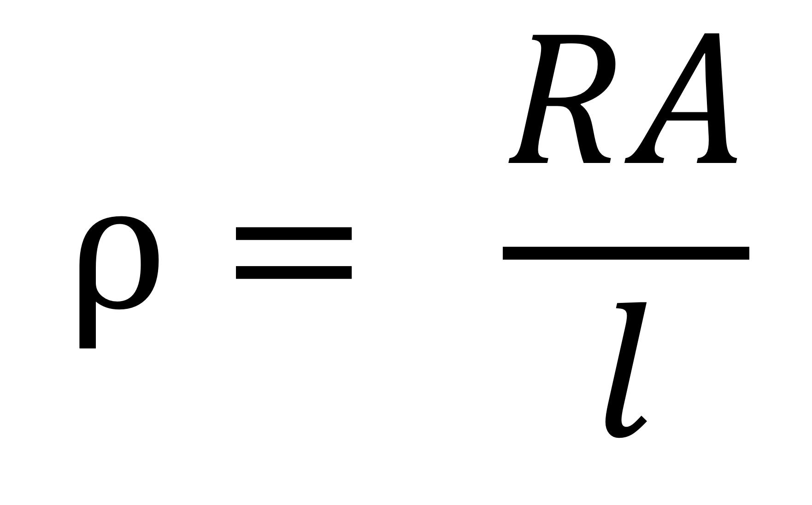
$$ρ= \frac{RA}{l}$$

Slide 95
Equation for calculating total resistance of resistors in series

Slide 96

$$R_{T}= R_{1}+R_{2}+R_{3}…$$

Slide 97
Equation for calculating total resistance of resistors in parallel

Slide 98
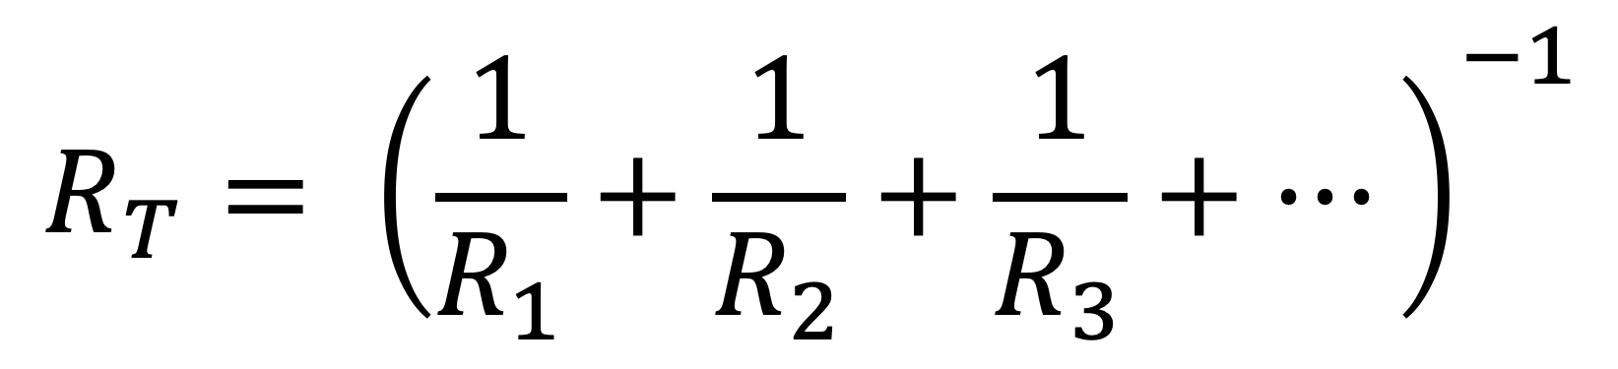
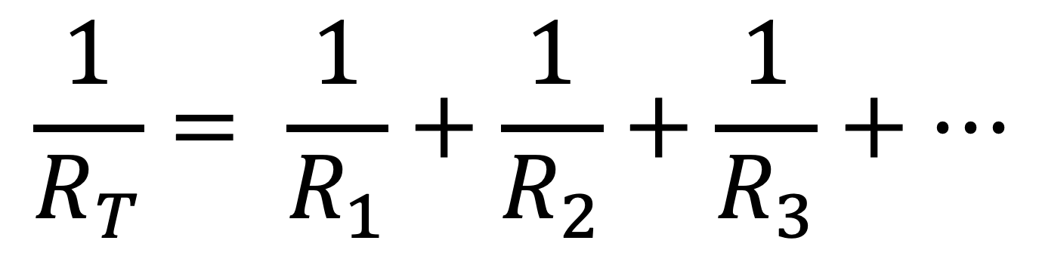
$$\frac{1}{R_{T}}= \frac{1}{R_{1}}+\frac{1}{R_{2}}+\frac{1}{R_{3}}+…$$
or
$$R_{T}= {\left(\frac{1}{R_{1}}+\frac{1}{R_{2}}+\frac{1}{R_{3}}+…\right)}^{−1}$$

Slide 99
Three equations for electrical power in a circuit

Slide 100
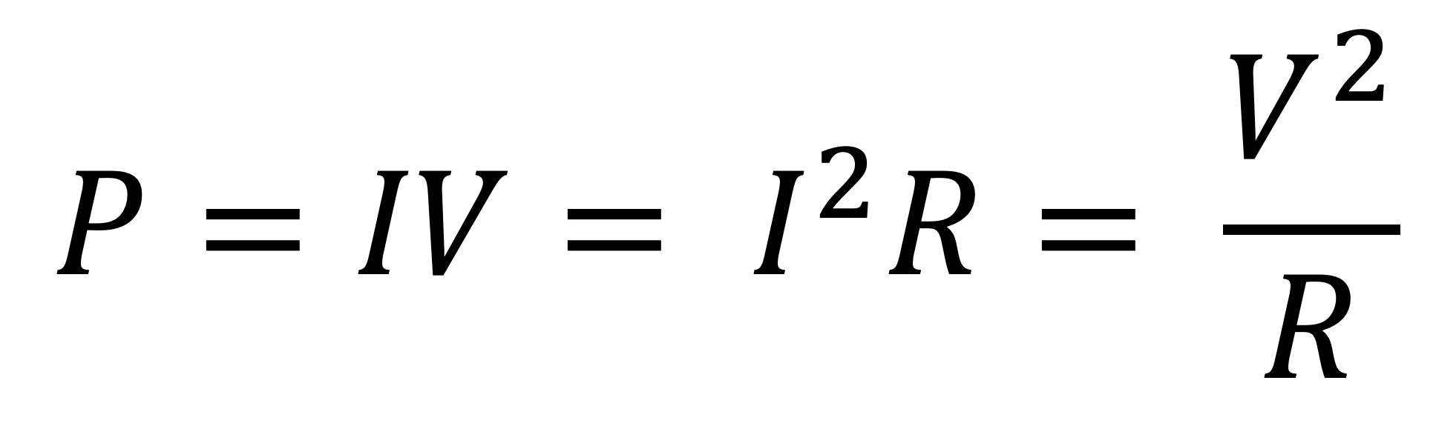
$$P=IV= I^{2}R= \frac{V^{2}}{R}$$

Slide 101
Equation relating p.d. and current to the total energy transferred by a component in a time, t.

Slide 102

$$E=ItV$$

Slide 103
Definition of electromotive force (emf) in words and symbols

Slide 104
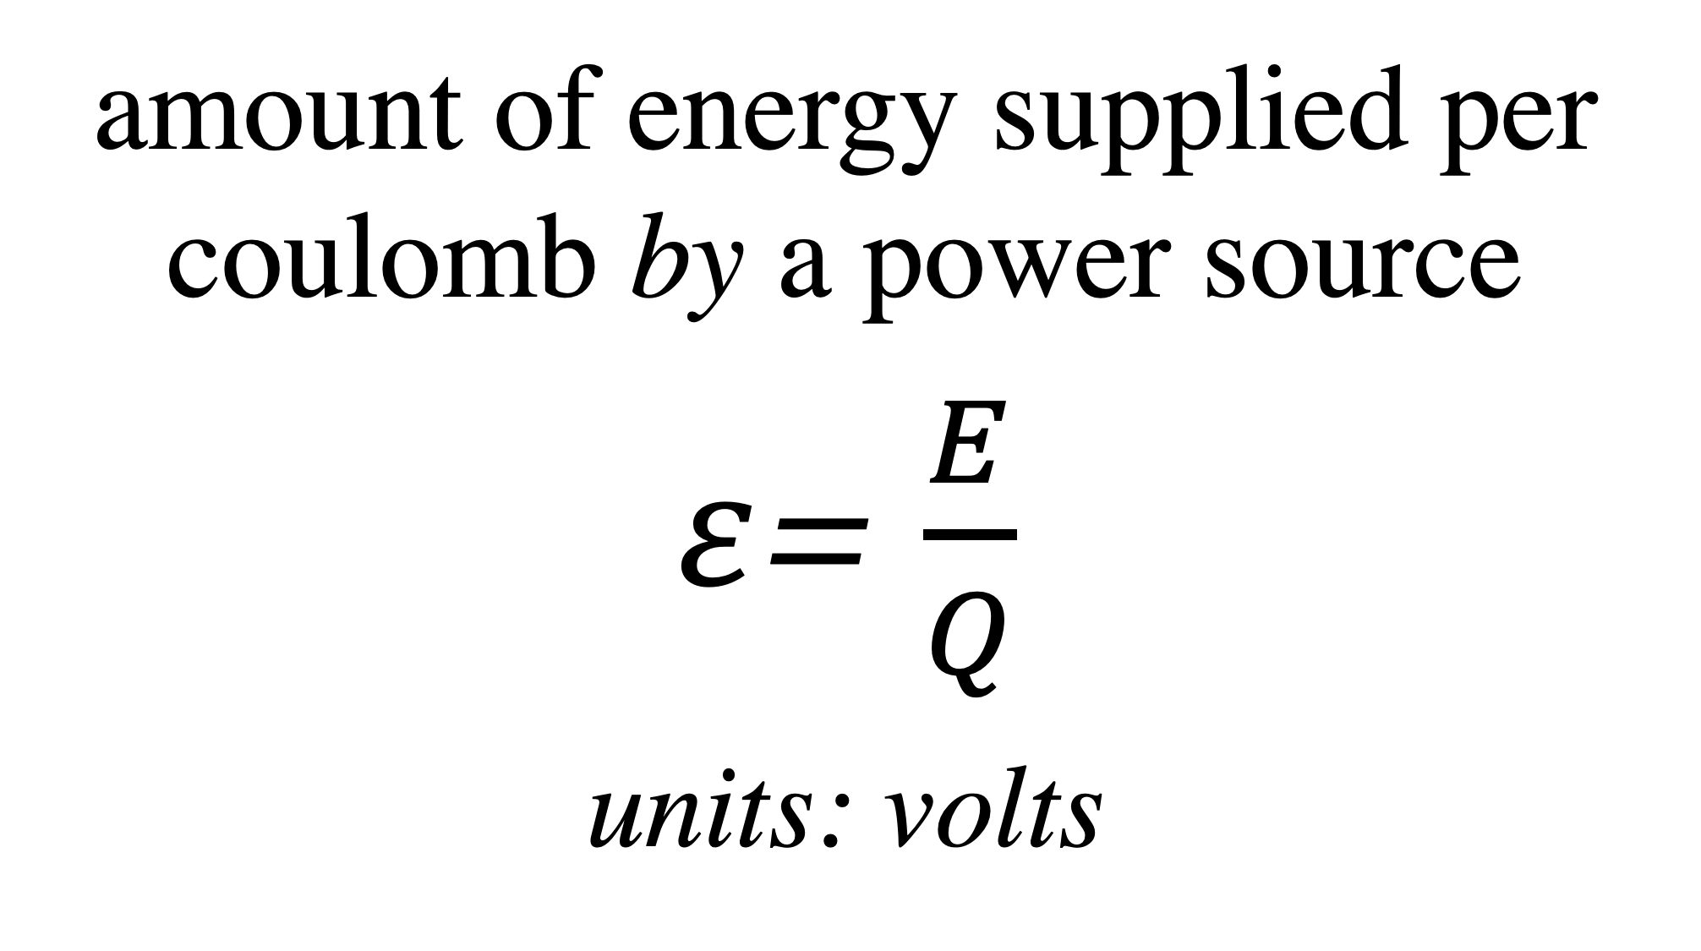
amount of energy supplied per coulomb by a power source
$ε$= $\frac{E}{Q}$
_{units: volts}

Slide 105
Equation relating emf of a power supply, its internal resistance and the external resistance in a circuit

Slide 106
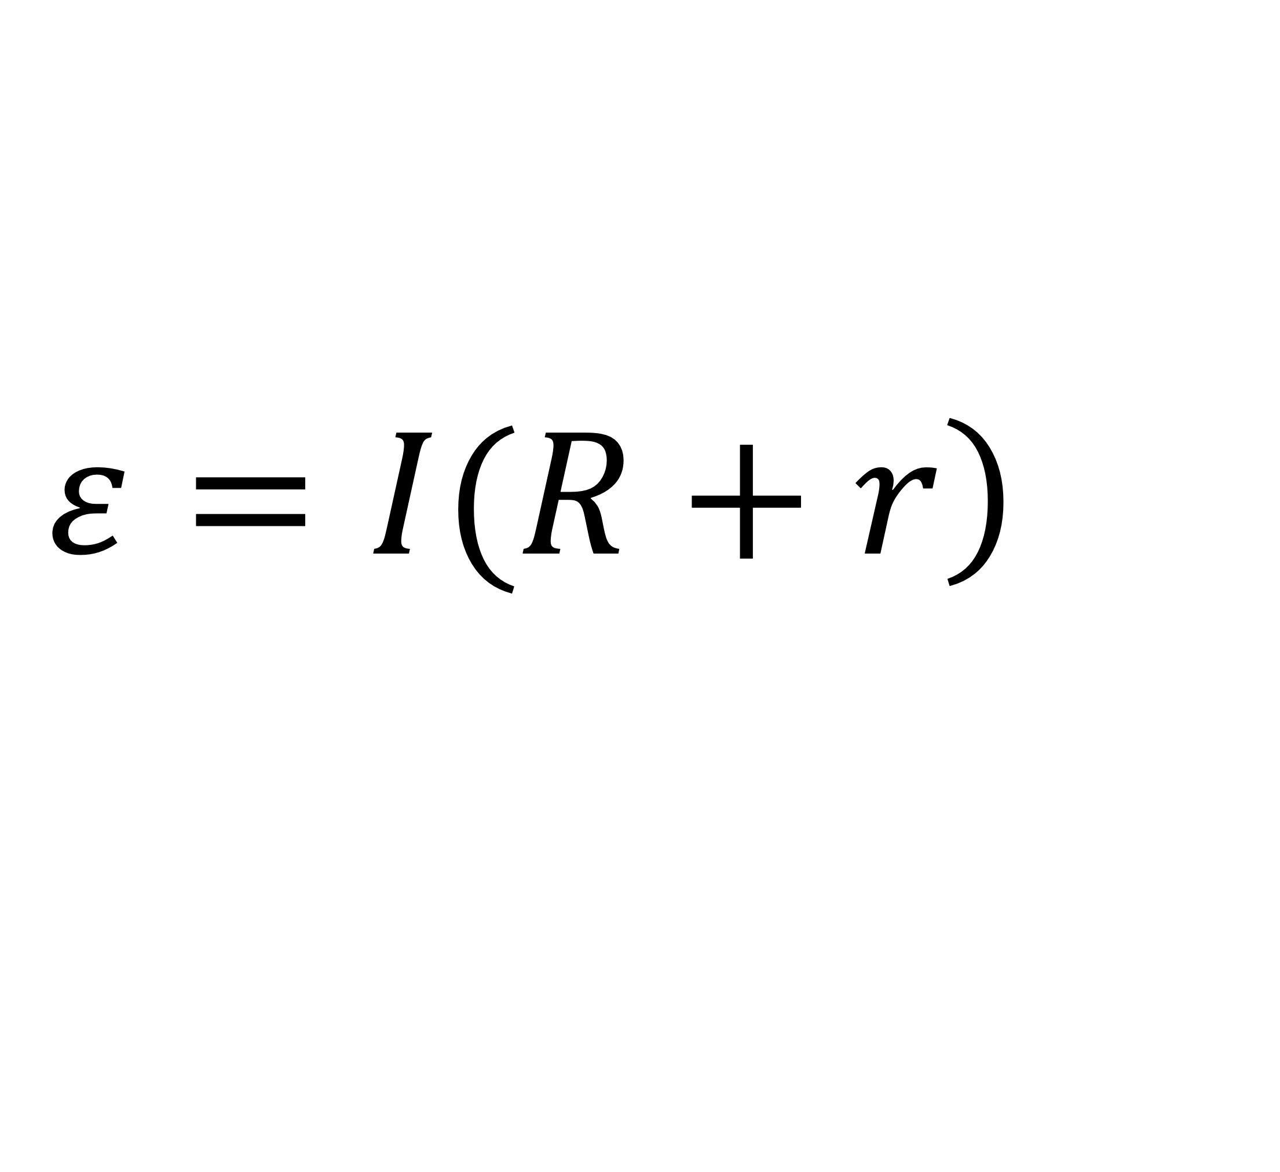
$$\left.ε=I(R+r\right)$$

Slide 107
Equation relating emf of a power supply, its internal resistance, the current through the circuit, and the p.d. across the external components

Slide 108
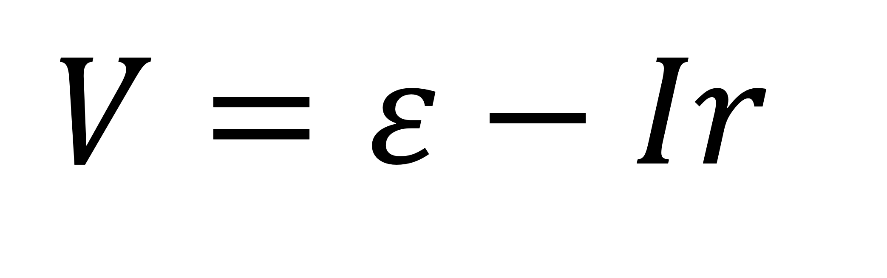
$$V=ε−Ir$$

Slide 109
Equation defining angular speed

Slide 110
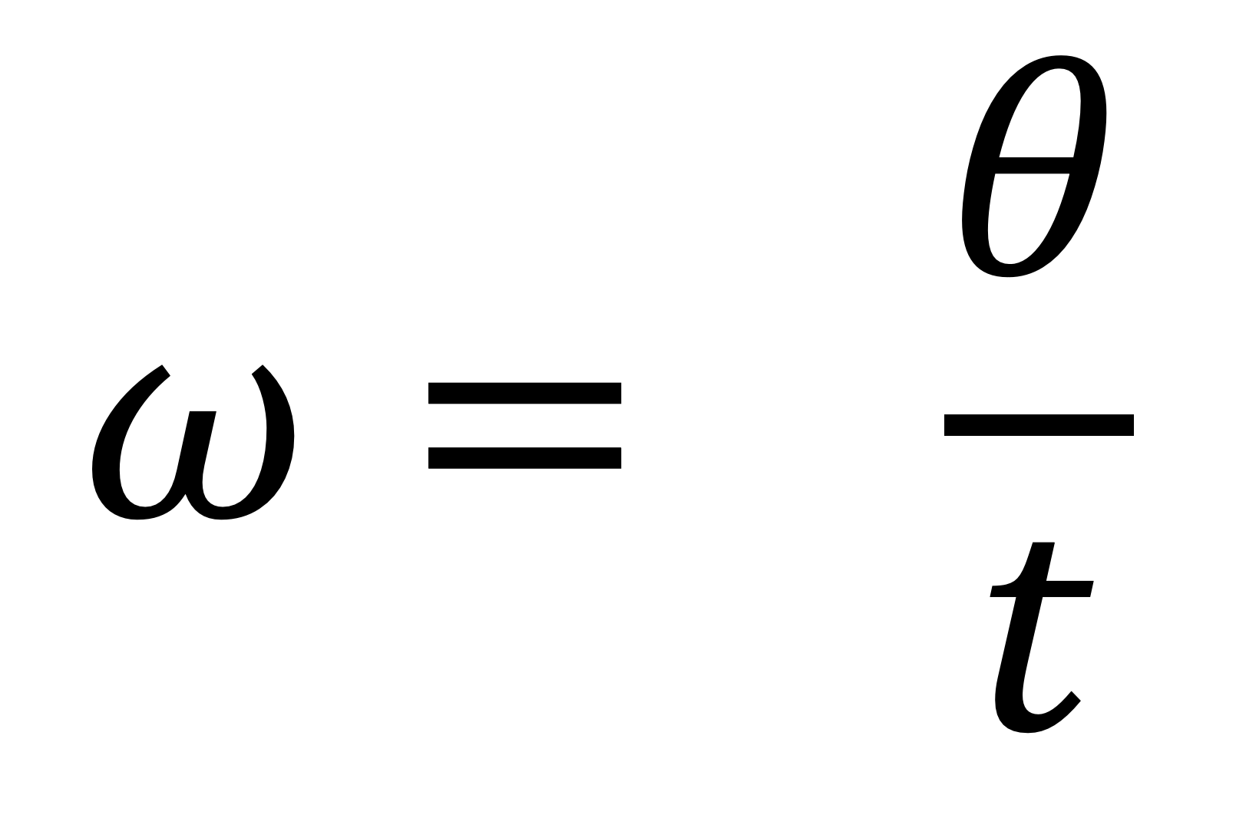
$$ω= \frac{θ}{t}$$

Slide 111
Equation relating angular speed to frequency of orbit

Slide 112
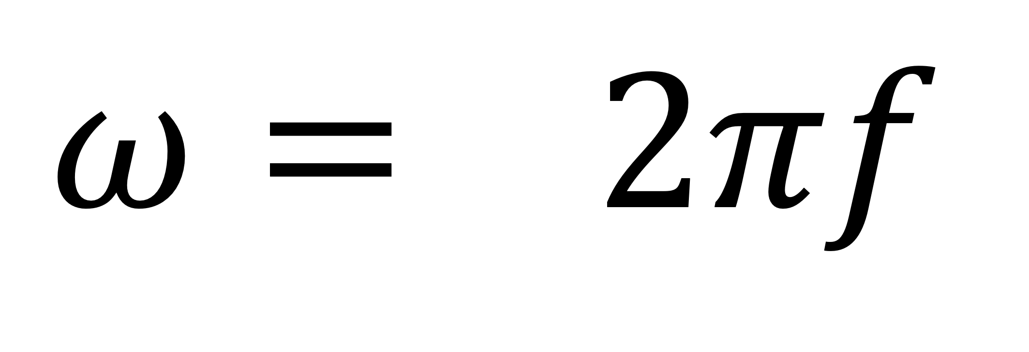
$$ω= 2πf$$

Slide 113
Equation relating angular speed to period of orbit

Slide 114
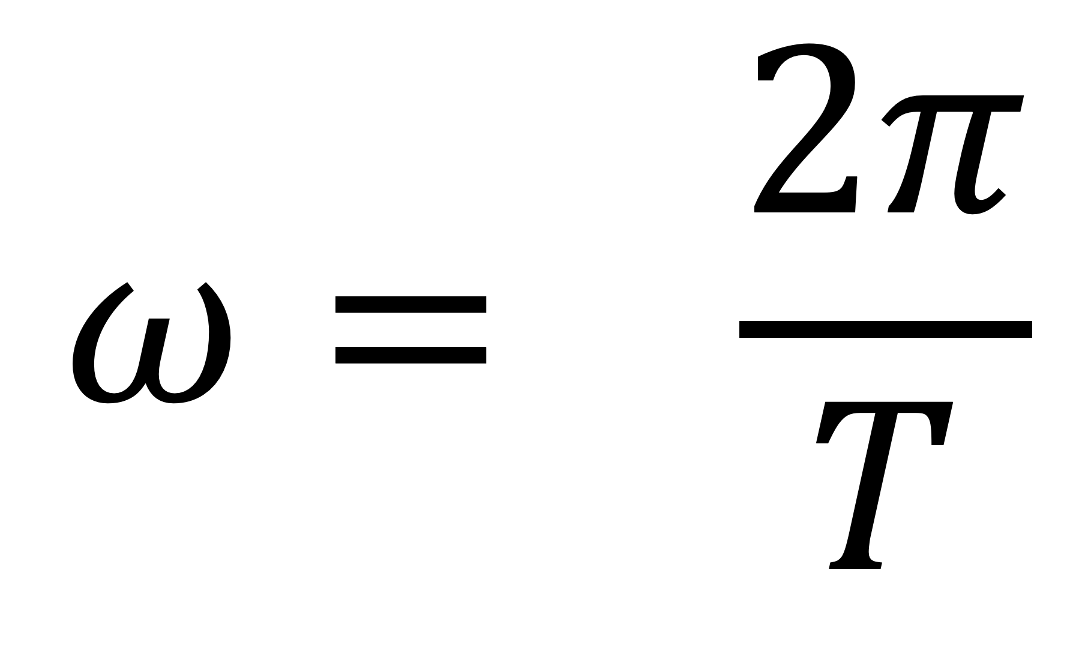
$$ω= \frac{2π}{T}$$

Slide 115
Equation relating angular speed to linear velocity and radius of orbit

Slide 116
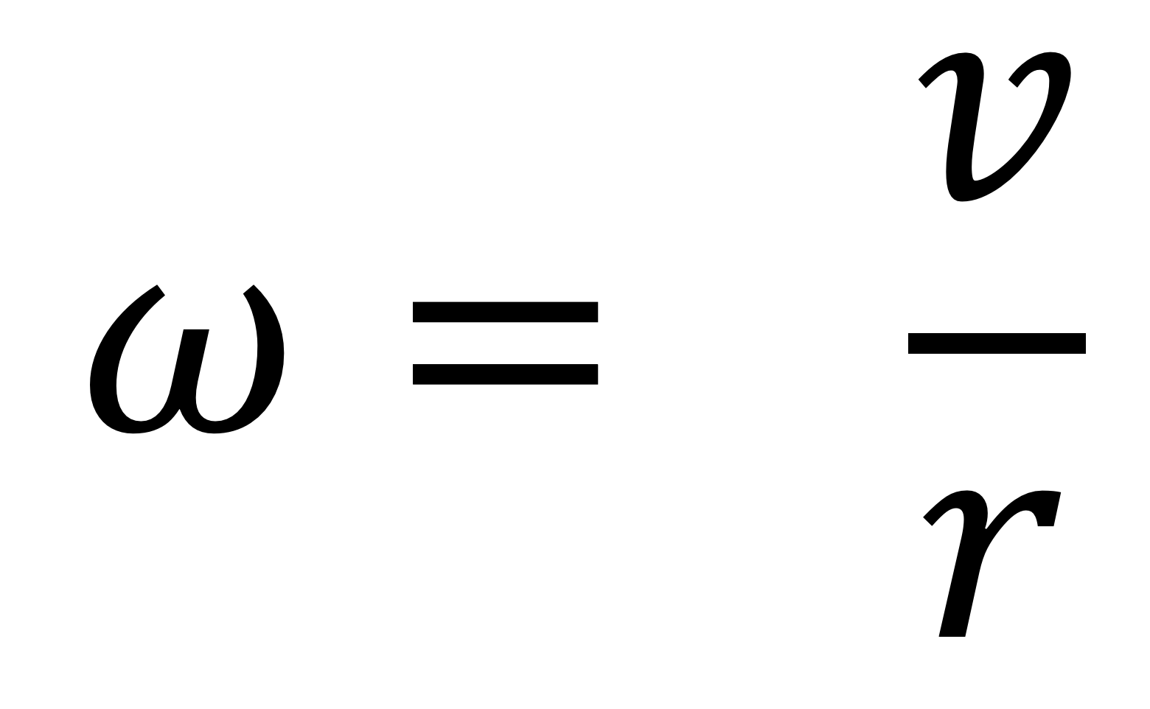
$$ω= \frac{v}{r}$$

Slide 117
Equation for centripetal force

Slide 118
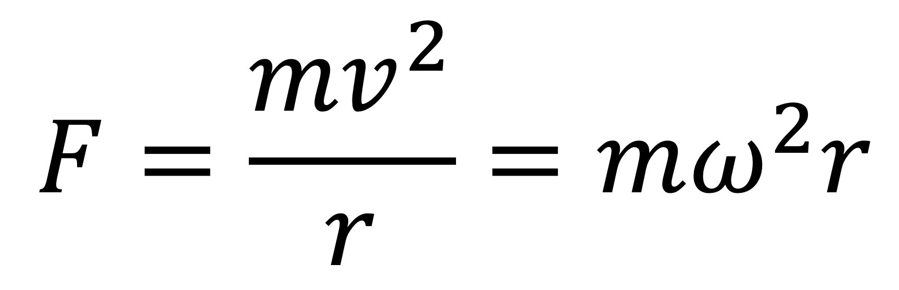
$$F=\frac{{mv}^{2}}{r}=mω^{2}r$$

Slide 119
Equations for centripetal acceleration

Slide 120
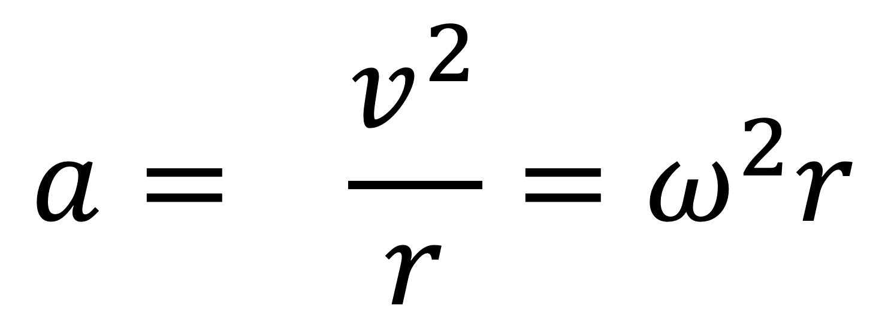
$$a= \frac{v^{2}}{r}=ω^{2}r$$

Slide 121
Criteria for
Simple Harmonic Motion (SHM)

Slide 122
Acceleration is proportion to the displacement, and always directed in the opposite direction, towards the equilibrium position

Slide 123
Equation relating acceleration and angular frequency in SHM

Slide 124
a = -ω²x

Slide 125
Equation for displacement in SHM

Slide 126
x = A cos(ωt)

Slide 127
Equation for speed in SHM

Slide 128
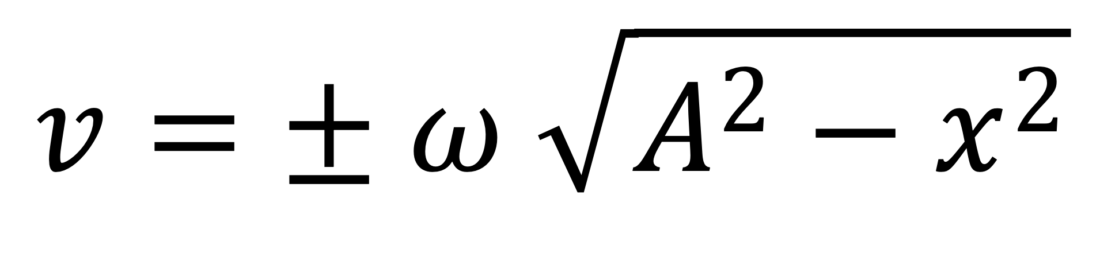
$$v=± ω \sqrt{A^{2}−x^{2}}$$

Slide 129
Equation for maximum speed in SHM

Slide 130

$$v_{max }=ωA$$

Slide 131
Equation for maximum acceleration in SHM

Slide 132

$a_{max }$ = ω²A

Slide 133
Equation for period of SHM in a mass-spring system

Slide 134

$$T=2π\sqrt{\frac{m}{k}}$$

Slide 135
Equation for period of SHM of a simple pendulum

Slide 136

$$T=2π\sqrt{\frac{l}{g}}$$

Slide 137
Definition of specific heat capacity

Slide 138
Definition of specific latent heat of fusion

Slide 139
Definition of specific latent heat of vaporisation

Slide 140
Energy needed to change temperature of a substance

Slide 141

$$Q=mcΔθ$$

Slide 142
Energy needed to change state of a substance

Slide 143

$$Q=ml$$

Slide 144
Gas Law with Boltzmann Constant

Slide 145

$$pV=NkT$$

Slide 146
Gas Law with molar gas constant

Slide 147

$$pV=nRT$$

Slide 148
Kinetic Theory Equation

Slide 149

$$pV=\frac{1}{3}Nm{\left(c_{rms}\right)}^{2}$$

Slide 150
Kinetic Energy of a Gas Molecule

Slide 151

$$\frac{1}{2}m{\left(c_{rms}\right)}^{2}=\frac{3}{2}kT=\frac{3RT}{2N_{A}}$$

Slide 152
Relationship between Pressure, Temperature, and Volume

Slide 153

$$\frac{P_{1}V_{1}}{T_{1}}=\frac{P_{2}V_{2}}{T_{2}}$$

Slide 154
Gravitational force between two masses

Slide 155

$$F= \frac{{Gm}_{1}m_{2}}{r^{2}}$$

Slide 156
Word definition of gravitational field strength

Slide 157
Force per unit mass

Slide 158
Equation defining of gravitational field strength

Slide 159

$$g=\frac{F}{m}$$

Slide 160
magnitude of gravitational field strength in a radial field

Slide 161

$$g=\frac{GM}{r^{2}}$$

Slide 162
Work done in moving a mass in a gravitational field

Slide 163

$$ΔW=mΔV$$

Slide 164
Word definition of gravitational potential

Slide 165
the work done per unit mass in bringing a point mass from infinity to a point in a gravitational field
(unit: 𝐽𝑘𝑔⁻¹)

Slide 166
Equation for gravitational potential

Slide 167

$$V=−\frac{GM}{r}$$

Slide 168
Why is gravitational potential always negative?

Slide 169
zero gravitational potential is defined as being as being at infinity, and since work has to be done to a mass to get it to infinity, gravitational potential is always negative

Slide 170
Equation relating gravitational field strength and gravitational potential

Slide 171

$$g=−\frac{ΔV}{Δr}$$

Slide 172
Equation for escape velocity

Slide 173

$$v_{esc}=\sqrt{\frac{2GM}{r}}$$

Slide 174
Equation relating period of satellite orbit to radius of orbit

Slide 175

$$T^{2}= \frac{4π^{2}}{GM}r^{3}$$

Slide 176
Equation for gravitational potential energy in a radial field

Slide 177

$$E_{p}= −\frac{{Gm}_{1}m_{2}}{r}$$

Slide 178
force between two point charges

Slide 179

$$F=\frac{1}{4πε_{0}} \frac{Q_{1}Q_{2}}{r^{2}}$$

Slide 180
Word definition of electric field strength

Slide 181
Force per unit charge

Slide 182
definition of electric field strength in symbols

Slide 183

$$E= \frac{F}{Q}$$

Slide 184
Formula for electric field strength between two parallel plates

Slide 185

$$E= \frac{V}{d}$$

Slide 186
definition of uniform field

Slide 187
Field strength and direction same at all points

Slide 188
Work done in moving a charge in an electric field

Slide 189

$$ΔW=QΔV$$

Slide 190
Equation for field strength for a radial field

Slide 191

$$E=\frac{1}{4πε_{0}} \frac{Q}{r^{2}}$$

Slide 192
Equation for electric potential

Slide 193

$$V=\frac{1}{4πε_{0}} \frac{Q}{r}$$

Slide 194
Equation relating electric field strength and electric potential

Slide 195

$$E= \frac{∆V}{∆r}$$

Slide 196
Equation for electric potential energy at a point in a radial field

Slide 197

$$E_{p}=\frac{1}{4πε_{0}} \frac{Q_{1}Q_{2}}{r}$$

Slide 198
Equation relating capacitance, charge, and voltage

Slide 199

$$C= \frac{Q}{V}$$

Slide 200
Equation relating capacitance to area of plates, separation of plates, and permittivity of dielectric

Slide 201

$$C= \frac{Aε_{0}ε_{r}}{d}$$

Slide 202
Energy stored in a capacitor

Slide 203

$$E=\frac{1}{2}QV$$
$$E=\frac{1}{2}CV^{2}$$
$$E=\frac{1}{2}\frac{Q^{2}}{C}$$

Slide 204
Equations describing discharging a capacitor

Slide 205

$$Q=Q_{0}e^{−\frac{t}{RC}}$$
$$V=V_{0}e^{−\frac{t}{RC}}$$
$$I=I_{0}e^{−\frac{t}{RC}}$$

Slide 206
Equations describing charging up a capacitor

Slide 207

$$Q=Q_{0}{(1−e}^{−\frac{t}{RC}})$$
$$V=V_{0}{(1−e}^{−\frac{t}{RC}})$$
$$I=I_{0}e^{−\frac{t}{RC}}$$

Slide 208
Word definition of the time constant for a resistor-capacitor (RC) circuit

Slide 209
Time taken for the charge or potential difference or current to fall to 1/e of its original value for a discharging capacitor

Slide 210
Equation for calculating time constant for a discharging capacitor

Slide 211

$$τ= RC$$

Slide 212
Time taken for a capacitor to discharge 99% of its charge or current or potential difference

Slide 213
5 time constants

Slide 214
Equations defining relative permittivity

Slide 215

$$ε_{r}= \frac{C}{C_{0}}=\frac{Q}{Q_{0}}=\frac{ε_{1}}{ε_{0}}$$

